Slide 1
Міністерство освіти і науки Прикарпатский національний університет імені Василя Стефаника кафедра іноземних мов
Т. В. Поміркована
ENGLISH FOR MASTER’S DEGREE FOR THE FACULTIES OF MATHEMATICS AND INFORMATION TECHNOLOGY
Educational-methodical manual
Івано-Франківськ 2022

Slide 2
М 54 Рекомендовано до друку кафедрою іноземних мов Прикарпатського національного університету імені Василя Стефаника
Автор: Поміркована Т. В.
Рецензент: Козленко М.І., кандидат технічних наук, доцент, завідувач кафедри комп'ютерної та програмної інженерії національного університету імені Василя Стефаника.
Посібник з англійської мови / Поміркована Т.В. – Івано - Франківськ, 2022. – 98 с.
Пропонований посібник складено відповідно до навчальної програми з іноземної мови фахового спрямування і з урахуванням сучасних методів навчання. Посібник складається з десяти розділів. Кожний розділ містить тематичні тексти та творчі і комунікативні завдання. Мета посібника – допомогти студентам опанувати базову лексику, навчити їх основ перекладу фахової літератури й удосконалити комунікативні навички та вміння. Посібник можна використовувати для роботи в аудиторії та самостійних занять. Розраховано на студентів денної та заочної форми навчання.

Slide 3

Unit 1
WHAT IS SCIENCE?

Slide 4
Activity I.
Read and translate the following words and word combinations.
Curiosity, circumstances, purpose, to distinguish, to enable, unreliable, to widen, extent , occupation, to observe, phenomenon, surrounding world, an effort.
Activity II.
Make up sentences with the words given in task 1.

Slide 5
Activity III.
Try to guess the meaning of the following phrases
1. set of circumstances — a number of conditions or facts, connected with an event or person, that belong together because they are similar or complementary.
2. to give rise to something — to be the cause of something, to suggest
3. in orderly fashion — in well-arranged order.
4. to keep pace with the times — to progress.
5. to increase the extent of our contact with unexplored areas — to widen and deepen the research.
6. to science we owe — we feel grateful to science for...
7. to mould the environment — to guide or influence the surrounding world.

Slide 6
Activity VI.
Read the text and discuss it. Write a synopsis of the text in five sentences.
WHAT IS SCIENCE?
Science is a human activity. Sciences arouse out of man's efforts to survive, his natural curiosity, his search for order in the surrounding world. It arouses from man's efforts to understand nature and himself.
In science you study nature and human nature, living nature and non-living nature. The fundamental aim of science is to describe the facts of nature and natural events. The basis of science is the belief that natural events have natural causes. When science looks for the cause of any given natural phenomenon, it is simply looking for a set of circumstances which gave rise to the event, circumstances which themselves grew out of a still earlier set of conditions. Science makes this search by observing facts, by organizing these facts in orderly fashion.
A secondary purpose of science is the formulation, on the basis of experimental facts, of principles and theories which are the generalizations, and which will lead to new studies and increased knowledge.
What distinguishes science from other activities is that it enables person to see the world "as it really is". This may mean different things to different persons at different times. Over the ages, science has found the world to be flat at one time, round at another and more recently "egg-shaped", to be the center of the Universe and, later only a speck in the cosmos, to be made up of four fundamental substances and, later, of more than one hundred fundamental substances.
This does not mean that science is unreliable. That means that science keeps pace with the times. Every new discovery widens the horizon and increases the extent of our contact with unexplored areas.
We all know that science plays an important role in the societies іn which we live. Through technology, science improves the structure of society and helps person to gain increasing control over his environment. To science we owe most of our comforts, our leisure, our health a longevity, our ability to mould environment, to communicate instantly and to move swiftly over the Earth.
Science is an occupation for people who are open-minded, who are capable of putting their beliefs to many tests. There is always room for freshness newness, and brightness in it. The openness and freedom of science make it the most advanced kind of thought humanity has so far developed.

Slide 7
Activity V.
Translate the following words and word combinations:
Людська діяльність, зусилля людини, природна цікавість, оточуючий світ, основна мета, шукати причину, природне явище, спричинити подію, у добре встановленому порядку, вести до нових досліджень, основні речовини, цятка в космосі, недосліджені області, здоров’я і довголіття, контролювати навколишнє середовище, відкритість та свобода.
Activity VI.
Answer the questions.
1. What do sciences arouse out of ?
2. What do you study in science?
3. What belief is the basis of science?
4. How does science make its searches?
5. What distinguishes science from other activities?
6. How does science improve the structure of society and help person to control environment?
7. What kind of people deal with science?
8. What makes science the most advanced kind of thought humanity has so far developed?

Slide 8
Activity VII.
Read the following statements from the text and comment them:
1. Science is first of all a human activity. Why is science considered to be the first of activities?
2. The fundamental aim of science is to describe the facts of nature and natural events. Has science got any other aims? Give the examples.
3. Science enables person to see the world "as it really is". Can you prove this statement?
4. In different times science treated the same facts in different ways. Does it mean that science is unreliable?
5. Science plays an important role in the societies іn which we live. What role does science play in your life? What science do you deal with? How is your future occupation connected with science?
Activity VIII.
Match the antonyms.
freedom openness instant different important natural | disbelief eventual uncommon dependency insignificant the same

Slide 9
Activity IX.
Translate the following sentences.
1. Наука – це вид людської діяльності. 2. Наука шукає причини певних природних явищ та намагається пояснити їх. 3. Наука досліджує багато факті в, а потім впорядковує результати своїх досліджень. 4. У різні часи наука по-різному трактувала одні й ті ж самі явища. 5. Наука завжди йде в ногу з часом. 6. Наука відіграє важливу роль у технічному прогресі будь-якого суспільства. 7. Наукою займаються люди, здатні багато разів експериментально перевіряти свої твердження.
Activity X.
Speak on the following problems and discuss them with your colleagues:
1. Science is unreliable and there is no need to believe the facts it has proved.
2. Only brave people with great imagination can deal with science.

Slide 10
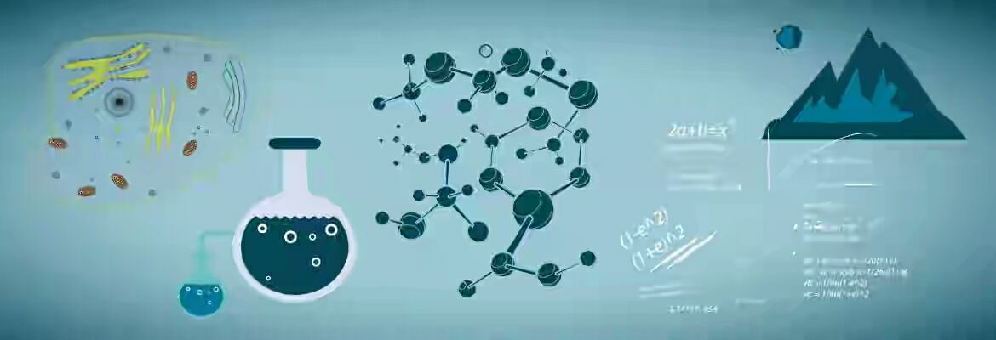
PURE AND APPLIED SCIENCE
Unit 2

Slide 11
Activity I.
Read and translate the following words and word combinations.
Pure and applied science, totally different activities, interconnection, to establish relationships, phenomena, the working laws of science, to carry out work, practical affairs, to confine attention to explanation, events.
Activity II.
State the part of speech of the following words and determine their meaning without using a dictionary.
1. Apply, appliance, applicable, applicator, application.
2. Act, action, active, activity, actor, activist.
3. Differ, difference, different.
4. Connect, connector, connection, connective, connectivity.
5. Relate, relation, relationship, relative, relatively, relativity, relativism, relativist.
6. Practical, practically, practice, practitioner.

Slide 12
Activity III
Try to guess the meaning of the following phrases
1. to be primarily concerned with — to be originally or principally involved or interested in...
2. to be sufficiently validated — to make something officially acceptable or approved.
3. to have (no) apparent connection — to have (no) evident (visible) relation.
4. to improve the sampling procedures — to make better the procedures of selecting samples, specimen.
5. to be evident — to be clear, easy to see.
6. to apply a particular concept — to use practically a specific (unusual) idea, notion.
7. to reveal a gap or limitation (in) ... — to show a blank space or restriction (in).

Slide 13
Activity IV
Read the text and discuss it. Write a synopsis of the text in five sentences.
PURE AND APPLIED SCIENCE
As students of science, you are probably sometimes puzzled by the terms "pure" and "applied" science. Are these two totally different activities, having little or no interconnection, as is often implied?
Pure science is primarily concerned with the development of theories (or, as they are frequently called, models) establishing relationships between the phenomena of the universe. When they are sufficiently validated these theories (hypotheses, models) become the working laws or principles of science. In carrying out this work, the pure scientist usually disregards its application to practical affairs, confining his attention to explanations of how and why events occur, hence, in physics, the equations describing the behaviour of fundamental particles, or in biology, the establishment of the life cycle of a particular species of insect living in a Polar environment are said to be examples of pure science (basic research), having no apparent connection (for the moment) with technology, i.e. applied science.
Applied science, on the other hand, is directly concerned with the application of the working laws of pure science to the practical affairs of life, and to increasing man's control over his environment, thus leading to the development of new techniques, processes and machines. Such activities as investigating the strength and uses of materials, extending the findings of pure mathematics to improve the sampling procedures used in agriculture or the social sciences, and developing the potentialities of atomic energy, are all examples of the work of the applied scientist or technologist.
It is evident that many branches of applied science are practical extensions of purely theoretical or experimental work. Thus, the study of activity began as a piece of pure research, but its results are now applied in a great number of different ways — in cancer treatment in medicine, the development of fertilizers in agriculture, the study of metal fatigue in engineering, in methods of estimating the ages of objects in anthropology and geology, etc. Conversely, work in applied science and technology frequently acts as a direct stimulus to the development of pure science. Such an interaction occurs, for example, when the technologist, in applying a particular concept of pure science to a practical problem, reveals a gap or limitation in the theoretical model, thus pointing the way for further basic research. Often a further interaction occurs, since the pure scientist is unable to undertake this further research until another technologist provides him with more highly developed instruments.
It seems, then, that these two branches of science are mutually dependent and interacting, and that the so-called division between the pure scientist and the applied scientist is more apparent than real.

Slide 14
Activity V
Translate the following words and word combinations:
Прикладна наука, не мати взаємозв’язків, розвиток теорії, зв’язки між явищами, робочі закони, практичне застосування, встановлення життєвого циклу, чиста наука, збільшення людського контролю, розвиток нових технологій, соціальні науки, практичне поширення, метод оцінки, прямий стимул, подальше дослідження, забезпечувати інструментами, поділ між теоретичною та прикладною науками.
Activity VI
Answer the following questions.
What definition of “pure science” does the author give?
When does a hypothesis become a principle of science?
What problems does the pure scientist deal with?
What is your own explanation of “pure science”?
What does the pure scientist disregard and what does he confine his attention to?
What is applied science concerned with?
What is the difference between pure and applied sciences?
How are these two branches of science interconnected?
How does applied science affect our daily life?

Slide 15
Activity VII
Match the synonyms.
apparent total different frequently primary probable practical particular | repeatedly principal constructive global special presumable various undisputed
Activity VIII. Complete the sentences:
1. Pure science is primarily concerned with ______ .
2. The pure scientist usually disregards _______.
3. Applied science is directly concerned with _______ .
4. Many branches of applied science are __________.
5. The study of activity began as a piece of _______ .
6. The results of pure research are now applied in _____ .
7. Work in applied science and technology frequently acts as _____.
8. Pure and applied sciences are mutually _____ .

Slide 16
Activi IX. Choose the correct word and fill in the blanks.
a. product (próduce) producer(s) production productive to produce productivity 1. We had a very ___ meeting last week. 2. The two lasers combine ___ a powerful cutting tool. 3. The country’s main ___ is oil. 4. New ___ methods have led to increased ___ . 5. This country is one of the leading oil ___ . 6. The wine bottle was marked «___ of France». b. to predict prediction predictable 7. The economists ___ an increase in the rate of inflation. 8. You’re so ___ ! 9. It is hard ___ when it will happen. 10. His ___ turned out to be correct. c. science scientific scientist 11. I’m fond of reading ___ fiction. | 12. He is a famous ___ . 13. I don’t need any ___ proof. d. (to) apply applied application(s) 14. This rule does not ___ in your case. 15. A new discovery has a lot of industrial ___ . 16. Her research is both theoretical and ___ . e. (to) require requirement(s) required 17. To carry out this plan would ___ increasing our staff by 20 %. 18. This monograph is ___ reading for our course. 19. Candidates who fail to meet these ___ will not be admitted to the university. f. (to) develop development 20. __ of skills was the most important stage. 21. I’d like ___ my idea.

Slide 17
Activity 10. Translate the following sentences.
1. Чиста та прикладна науки тісно пов’язані між собою. 2. Теоретична (чиста) наука займається розвитком теорій та встановленням зв’язків між різними явищами. 3. Якщо гіпотези підтверджуються, вони стають робочими законами. 4. Прикладна наука застосовує робочі закони теоретичної науки у практичних цілях. 5. Прикладна наука розробляє нові технології та створює різні механізми та машини. 6. Прикладна наука має великий вплив на різні галузі теоретичних та експериментальних досліджень. 7. Результати теоретичних досліджень завжди широко застосовуються у медицині, машинобудуванні, сільському господарстві тощо. 8. Інколи теоретичні дослідники не можуть продовжувати своє дослідження без спеціальних інструментів, запропонованих практичною наукою. 9. Теоретична і прикладна науки є взаємозалежними і не можуть обійтися одна без одної.
Activity 11. Speak on the following problems and discuss them with your colleagues:
a) difference between pure and applied sciences;
b) mutual dependence between pure and applied sciences.
c) Summarize the general information about the investi­gation of your own.

Slide 18

Unit 3
THE SCIENTIFIC ATTITUDE

Slide 19
Activity 1
Read and translate the following words and word combinations.
Scientific attitude, to find out, to direct, underlying relationships, persistent, to utilize, velocity, to reject, authority, to verify, installment, impartial
Activity 2
Make up sentences with the words given in activity 1.
Activity 3
Try to guess the meaning of the following phrases.
1. to be full of curiosity — to be full of desire to learn or know.
2. pure and applied knowledge — theoretical and practical body; facts accumulated by mankind.
3. to solve the problem — to find the answer to.
4. to apply persistent and logical thought — to use practically сonstantly repeated and correct reasoning of an idea (concept).
5. man is the least reliable of scientific instruments — a human being is in the smallest degree true (trustworthy) scientific means.
6. to disturb impartial and objective investigation — to break up fair and real (without bias or prejudice) careful search.

Slide 20
Activity 4
Task 4. Read the text and discuss it. Write a synopsis of the text in five sentences.
THE SCIENTIFIC ATTITUDE
What is the nature of the scientific attitude, the attitude of the man or woman who studies and applies physics, biology, political science, chemistry, psychology, engineering, management, medicine or any other science?
What are these special methods of thinking and acting? First of all, it seems that a successful scientist is full of curiosity he wants to find out how and why the universe works. He usually directs his attention towards problems which he notices have no satisfactory explanation, and his curiosity makes him look for underlying relationships even if the data available seem to be unconnected. Moreover, he thinks he can improve the existing conditions, whether of pure or applied knowledge, and enjoys trying to solve these problems which this involves.
He is a good observer, accurate, patient and objective and applies persistent and logical thought to the observations he makes. He utilizes the facts he observes to the fullest extents. For example, trained observers obtain a very large amount of information about a star (e.g. distance mass, velocity, size, etc.) mainly from the accurate analysis of the simple lines that appear in a spectrum.
He is skeptical — he does not accept statements which are not based on the almost complete evidence available — and therefore rejects authority as the sole basis of truth. Scientists always check statements and make experiments carefully and objectively to verify them.
Furthermore, he is not only critical of the work of others, but also of his own, since he knows that man is the least reliable of scientific installments and that a number of factors tend to disturb impartial and objective investigation.
Lastly, he is highly imaginative since he often has to look for relationships in data which are not only complex but also frequently incomplete. Furthermore, he needs imagination if he wants to make hypotheses how process works and how events take place.
These seem to be some of the ways in which a successful scientist or technologist thinks and acts.

Slide 21
Activity 5
Translate the following words and word combinations:
Спрямовувати увагу, існуючі умови, спостереження, доступні дані, задовільне пояснення, здаватися непов’язаними між собою, прикладні знання, велика кількість інформації, точний аналіз, відкидати авторитетні джерела, перевіряти твердження, надійний науковий інструмент, неупереджене дослідження.
Activity 6
Read the following statements from the text and comment them:
1. A successful scientist is full of curiosity. ‘Curiosity’ is a children’s quality. Can we treat a scientist like a child? Is it necessary for a grown-up person who deal with science to be curious? Why?
2. A successful scientist is a good observer. Nowadays there is a great number of different devices for observation, so perhaps it’s needless for a scientist to be a good observer because these devices can perform all his work.
3. Authoritative sources are proved by different scholars, so they are reliable. Why should a successful scientist reject them?
4. Do you agree with the statement that a successful scientist needs imagination? Prove it.

Slide 22
Activity 7
Translate the following sentences.
1. Справжній вчений повинен бути допитливим для того, щоб виявляти та досліджувати невідомі явища природи. 2. Проблеми та явища, які не мають задовільного пояснення, завжди привертають увагу вчених. 3. Хороший вчений повинен бути спостережливим, терплячим та об’єктивним для того, щоб проаналізувати та застосувати свої спостереження на практиці. 4. У своїх дослідженнях вчені ніколи не покладаються лише на авторитетні та перевірені джерела і таким чином рухають науку уперед. 5. Для підтвердження своїх гіпотез вчені проводять багато експериментів. 6. Щоб зробити щось неможливе дослідники повинні мати добре розвинену уяву.
Activyty 8
Speak on the following problems and discuss them with your colleagues:
a) You are a successful scientist. Give some useful advice to your young colleague about the qualities he/she should possess.
b) Discuss the qualities you consider to be the most and the least important for a good scientist.

Slide 23

Unit 4
THE SCIENTIFIC METHOD

Slide 24
Activity 1
Read and translate the following words and word combinations.
Recognition, sequence of procedures , to establish, to obtain, solely, to sway, to list, solution, to discard, substantiating data, eventually, rank, abandonment of the hypothesis .
Activity 2
Make up sentences with the words given in activity 1.
Activity 3
Try to guess the meaning of the following phrases.
1. sequence of procedures — the regular order of doing things.
2. the emphasis passed from ... to — something became more important than which accounts.
3. satisfactorily for — which is a good explanation.
4. of amount of substantiating data — number of facts that support hypothesis.
5. hypothesis advances to the rank of a theory — hypothesis gradually changes into a theory.

Slide 25
Activity 4
Read the text and discuss it. Write a synopsis of the text in five sentences.
THE SCIENTIFIC METHOD
As man's knowledge of natural phenomena increased, there came a time when he recognized that his growing knowledge of nature was the result of his application of a particular method of investigation. It seemed clear that a special sequence of procedures was applied to establish the working principles of science. The emphasis passed from the knowledge itself to the method by which that knowledge was obtained. This rather well-defined procedure has come to be known as the Scientific Method. The steps in the procedure may be listed as follows:
First — the recognition of the problem. Second — collection of relevant facts or data. Third — analysis of data and proposing a solution (і. e. а hypothesis). Fourth — performance of test experiments. Fifth — acceptance, modification or abandonment of the hypothesis in the light of the results of the test experiments.
If the hypothesis is discarded as the result of the test experiments, a new one will be set up and steps three, four and five will be repeated until an explanation is found which accounts satisfactorily for all the known experimental facts. As the amount of substantiating data becomes larger and larger, the hypothesis advances to the rank of a theory and eventually may be accepted as true. It should be noted that in general one adopts first the most obvious hypothesis, that is, the one that at the moment seems to offer the simplest explanation of the observed facts. This hypothesis may or may not prove to be satisfactory in the light of later evidence.
In coming to a conclusion about any hypothesis, the true scientists are swayed only by experimental evidence. They are not, for instance, governed principally by what they or anyone else want the result to be, by the reputation of the man who advanced the hypothesis, by what the majority of people think about it, or by any similar emotional reaction to the problem. They will constantly check their conclusions and hypotheses by experiment and be guided solely by the results thus obtained.

Slide 26
Activity 5. Translate the following words and word combinations:
Метод дослідження, застосовувати ряд процедур, встановлювати принципи, визнання проблеми, контрольні експерименти, відкидати гіпотезу, перейти до розряду теорії, найочевидніша гіпотеза, найпростіше пояснення, висувати гіпотезу, перевіряти висновки, керуватися отриманими результатами.
Activity 6. Match the terms with their definitions:
conclusion data method experiment hypothesis explanation | the information that someone gives to make something clear or easy to understand to test or to try a new way of doing something; a particular way of doing something; the opinion you have after considering all the information about something; facts or numbers, collected to be examined and considered and used to help with making decisions; An idea for something that may be true but has not yet been completely proved.
Activity 7. Put in the words from Activity 6 into the sentences:
1. A theoretical … of these unexpected findings seems in order. 2. Furthermore, we make the …. that the radiation source is optically thin. 3. It was designed to facilitate the combination of qualitative … with statistical analysis. 4. Although their summaries disagree in detail, they do agree on several … that support my interpretation of timing. 5. Our first … demonstrates that it is precisely the case. 6. The student’s task was to prepare all the posters and electronic … for the publicity campaign.

Slide 27
Activity 8. Choose the right variant:
1. People’s growing knowledge of nature is the result of … a) proving obvious hypothesis; b) a successful experiment; c) application of a particular method of investigation. 2. If the hypothesis is discarded … a) relevant facts or data will be collected; b) a new hypothesis will be set up; c) a scientist will offer the simplest explanation of the observed facts. | 3. In general a scientist adopts first … a) the most obvious hypothesis; b) known experimental facts. c) the method by which knowledge was obtained. 4. The true scientists are swayed only by … a) the reputation of the man who advanced the hypothesis; b) what the majority of people think about a certain fact; c) experimental evidence.
Activity 9. Translate the following sentences.
1. Виникнення наукового методу було спричинене збільшенням людських знань про природу і навколишнє середовище. 2. Порядок проведення певних дій спонукав встановлення наукових принципів дослідження. 3. Наукове дослідження проводиться у декілька етапів. 4. Постановка проблеми та аналіз даних є невід’ємними складовими наукового дослідження. 5. Якщо гіпотеза не підтверджується експериментами, то висувається нова гіпотеза і вчені шукають її підтвердження. 6. Зазвичай спочатку приймається найочевидніша і найпростіша на даний момент гіпотеза. 7. Справжній вчений керується лише підтвердженими експериментальними даними і завжди перевіряє свої висновки та гіпотези.
Activity 10. Speak on the following problems and discuss them with your colleagues:
a) methods, you are going to apply in your investigation;
b) the hypothesis existing in the area of your investigation.
c) describe the materials and methods used in one of your own investi­gations.

Slide 28

Unit 5
RESEARCH WORK (GENERAL REVIEW)

Slide 29
Activity 1. Read and translate the following words and word combinations: to integrate, a graduation paper, to be led out under the guidance, to number, contribution, to maintain, close links, a core subject, to meet the requirements.
Activity 2. Make up sentences with the words given in task 1.
Activity 3. Try to guess the meaning of the following phrases
1. to acquire skills in research — to gain practical knowledge and ability to conduct an investigation.
2. scientific adviser/supervisor — a person who holds an academic degree and guides the students and postgraduates’ research.
3. ranging from very basic to very practical — extending from fundamental theoretical to applied practical (research).
4. staff members — those working in an establishment, institution or organization.
5. to carry out investigations — to research something systematically in order to discover and interpret new knowledge.
6. to prepare a paper — to prepare a scientific contribution to be read to a learned society or to be published.

Slide 30
Activity 8. Read the text and discuss it. Write a synopsis of the text in five sentences.
RESEARCH WORK
University successfully integrates education with research. The final stages of the University programme include acquiring skills in research. The students carry out research mainly for their graduation paper, which reflects the knowledge and the practical skills in their certain field of science. Research can be led out under the guidance of a supervisor (scientific advisers).
The University has a broad programme of activities ranging from the very basic to the very practical and can perform various research. The University professional staff members number some thousand employees engaged in multiple research projects in different branches of science. Their achievements have been recognized and staff members, most of whom have academic degrees, have been honoured by the presentation of titles, certificates and awards. Many of the scientists are known internationally for their contributions. Research teams, working at various scientific projects, collaborate with their colleagues abroad and maintain close links with many research institutes and universities world-wide.
A great number of postgraduate students undertake a programme of study and research under the supervision of senior staff members who hold candidate or doctorate degree. The postgraduate course lasts three years during which time the young scientists and researchers carry out their investigations and prepare thesis on it. Their work should be conducted on the high scientific and technical level and the results of it should be practically applicable.
The postgraduate course programme provides attending seminars and colloquiums, taking qualifying exams in the core subjects, in philosophy and English, preparing research publications and written reports on the work carried out.
The postgraduate research may be theoretical and applied, often both. The scientific adviser assists his postgraduate students in many ways. He regularly meets them to discuss the progress in their work and to advise them in solving their current problems. While the thesis is being written the supervisor reviews its major sections and makes critical comments on each draft. The postgraduates are assisted in preparing articles and papers on their research. When the postgraduate completes his or her thesis, he/she submits it to the Academic Council of University and further defends it before the Academic Council. If the thesis meets all necessary requirements it is accepted by the Academic Council which takes the decision to award the postgraduate the higher academic degree.

Slide 31
Activity 5. Translate the following words and word combinations:
Поєднувати освітню та дослідницьку роботу, проводити дослідження, викладацький колектив університету, різноманітні проекти, науковий ступінь, бути нагородженим, звання, дослідницький колектив, співпрацювати з закордонними колегами, письмовий звіт, поточні проблеми, приймати рішення.
Activity 6. Identify the nouns, adjectives, adverbs and verbs in the following groups of words. Use the appropriate ones in the sentences below. Choose the correct form of the word.
a research to research a researcher
1. There is clearly a need for further ________ on this topic.
2. A software package entitled ”NN” integrates data that have been compiled by independent__________ .
3. They have been ______ the effects of the drug on mice.
4. This book by itself does not provide all the tools to become a creative _____ in mathematics.
5. The subject has not been fully _____ before.
6. A few _____ challenge this assessment, offering intriguing alternative models.
7. She teaches a lot of classes and doesn't have much time for her own ______ .
System systematic systematically systematizes systematization unsystematically
1. Rhetoric provides a framework in which these matters may be _____ investigated.
2. They are introducing a very sophisticated _____ for delivering information.
3. The positive side of _____ methodologies is that they can heighten a researcher’s appreciation of the complexities of the world.
4. We can ____ this concept by classifying it into a number of distinct categories.
5. Formalization is an outgrowth of the broader goals of scientific _____ .
6. Satellite communication _____ can alter the industrial paradigm in developing countries.
7. The collection has been _____ updated.

Slide 32
Activity 7. Complete the sentences:
1.The final stages of the University programme include _____ .
2. The graduation paper reflects _____ .
3. Research can be led out under the guidance of _____ .
4. The University professional staff numbers _____ .
5. Research teams collaborate with _____ .
6. The postgraduate course lasts _____ .
7. The postgraduate research may be _____ .
8. When the postgraduate completes his or her thesis, he/she _____ .
Activity 8. Put questions to underlined words.
1. The graduation paper reflects the knowledge and the practical skills in the particular field of science.
2. The University staff is engaged in multiple research projects in different branches of science.
3. Many of the scientists are known internationally for their contributions.
4. The young scientists and researchers carry out their investigations and prepare thesis on it.
5. The scientific adviser assists his postgraduate students in many ways.
6. The supervisor reviews the major sections of the thesis and makes critical comments on each draft.
7. The Academic Council takes the decision to award the postgraduate the higher academic degree.

Slide 33
Activity 9. Answer the questions.
What do the final stages of the University programme include?
2. What do the students carry out their research for?
3. Who is the research led by?
4. How many staff members are there in the University?
5. What activities are the staff members engaged in?
6. What do the postgraduates do during the course of their study?
7. How long do the postgraduate course last?
8. What exams do the postgraduates take?
9. Who helps them with their research?
10. How does the supervisor help his postgraduates?
11. What does a postgraduate do when he/she completes his or her thesis?
12. When do the Academic Council take the decision to award the postgraduate the higher academic degree?
Activity 10. Translate the following sentences.
1. Наш університет успішно поєднує навчальну і дослідницьку роботу. 2. Випускна робота, як правило, відображає знання та практичні навички у певній галузі науки. 3. Студенти й аспіранти проводять свої дослідження під керівництвом наукового керівника. 4. Працівники університету залучені до роботи над різноманітними дослідницькими проектами у різних галузях науки. 5. Багатьох наших науковців знають не лише в Україні, але й за кордоном. 6. Навчання в аспірантурі триває три роки. 7. Протягом цього часу аспіранти відвідують лекції, семінари, колоквіуми, та здають кандидатські іспити. 8. Наукове дослідження , зазвичай, складається з теоретичної та практичної (прикладної) частин. 8. Науковий керівник допомагає аспіранту у вирішенні поточних проблем. 9. Завершене дисертаційне дослідження подається на розгляд до спеціалізованої вченої ради. 10. Якщо дисертація відповідає всім вимогам, то аспірантові присуджують науковий ступінь.

Slide 34
Task 11. Make a list of the most important points for you in the text.
Task 12. Speak on the following problems and discuss them with your colleagues:
The benefits of the research.
Research promotes quality improvement of personnel training.
Research helps to achieve your goal.
Research develops understanding and decision-making.

Slide 35


Unit 6
THE RESEARCH PROCESS

Slide 36
Activity 1. Read and learn the following words and word combinations.
to anticipate v. apparent a. aptitude n. to clarify v. consistent a. convincing a. to elaborate v. to neglect v. parsing n. plausible a. to refute v. to reject v. review v. scope n. to set v. to spring up v. | передбачати безперечний, наочний здатність, схильність до чого-н. з’ясувати, виявити сумісний, узгоджений переконливий розробляти, розвивати заперечувати, нехтувати граматичний аналіз правдоподібний, прийнятний, ймовірний спростовувати відхиляти робити огляд, рецензувати, переглядати межі дії, рамки встановлювати виникати, з’являтись

Slide 37

Activity 2. Translate the following sentences:
This test did not reject the hypothesis proposed by our scientists.
Our purpose here is to elaborate these analytical dimensions in relation to workplace discourse.
We should not become so wrapped up in our work that we neglect our family or our health.
It can be an effective tool to clarify problems and identify appropriate interventions or solutions. There is no convincing evidence to support his theory.
The findings of the present 5-year longitudinal study are consistent with this theoretical claim.
Further studies are thus required to confirm or refute this association.
We are going to widen the scope of the investigation.
There are very good reasons why we need to be able to see or hear what is out there, rather than what we anticipate.

Slide 38
Activity 3. Read the text and discuss it. Write a synopsis of the text in five sentences.
Most research textbooks represent research as a multi-stage process that you must follow to undertake and complete your research project. The precise number of stages varies, but they usually include formulating and clarifying a topic, critically reviewing the literature, choosing a strategy, collecting data, analyzing data, and writing up. You may suggest that the research process is rational and straightforward. Unfortunately, this is very rarely true, and the reality is considerably messier. While research is often depicted as moving through each of the stages outlined below, one after the other, this is unlikely to be the case. In fact, you will probably revisit each stage more than once. Each time you revisit a stage you will need to reflect on the associated issues and refine your ideas. Research is sometimes described using the hourglass model. The hourglass model starts with a broad spectrum for research, focusing in on the required information through the methodology of the project (like the neck of the hourglass), then expands the research in the form of discussion and results.
The whole process of research can be divided into the following steps:
setting general area of research;
defining the object of research;
analyzing problem situation and stating a problem;
specifying the subject of research;
formulating a research goal;
setting objectives;
moving a hypothesis;
developing research methods;
collecting, describing, interpreting research data;
drawing conclusions, proving a hypothesis and resolving a research puzzle; determining application areas;
writing research project.

Slide 39
Any research starts with setting a research area which is determined by several objective and subjective factors. The objective determinants are such as topicality, novelty, urgency of the research. The subjective factors include scientific and professional interests of a researcher, his expertise, aptitudes, frame of mind, etc.
The object of the research is always broader than the subject chosen for research. It is a system of relations and properties of the phenomenon which exists objectively in theory and in practice and serves as a source of relevant information. The subject of the research is more concrete and includes only those relations and properties which are subject to direct investigation. It denotes what the author is planning to create in the process of studies.
A research problem is a puzzle that can’t be explained with available knowledge and needs solution. In the introduction to the research paper, it is necessary to prove that the chosen problem is topical. A problem is topical if it meets at least three requirements:
the problem has not been fully studied;
much or something in the problem remains vague;
lack of knowledge on the problem makes a loss to community.
To prove that the problem chosen for the research is topical the author gives a review of the previously published papers on the topic and a list of authors who were active in the studies of the problem. Then he/she mentions that though the problem has been given considerable attention, still something is not known and makes concrete what is still unknown on the topic. One also mentions what is still vague and needs elaboration. Then the author describes difficulties that spring up because the problem of his/her research has not been fully studied.
There is usually one major goal of research with objectives. The wish of the author to study a problem is expressed usually in one sentence which says that the goal of the research is to study the defined topic. Concrete objectives are further specified. The tasks of the research are usually the following:

Slide 40
to clarify the nature and structure of the phenomenon being researched;
to analyze the approaches to the research topic in literature;
to describe aspects of the research topic by observation;
to generate a model;
to carry out an experiment;
to analyze experimental results;
to find out the ways of improving efficiency of the phenomenon under research.
The tasks (objectives) of research are set in order to plan the steps of the research. They may correspond to the order of the units and chapters of the research paper as a whole.
A hypothesis is a tentative assumption that proposes a possible explanation to some phenomenon or event. A hypothesis is said to be forceful if the assumption is not obvious from the very beginning of the research and really needs to be well proved. Researchers weighing up alternative hypotheses should take into consideration:
testability;
simplicity;
scope - the apparent application of the hypothesis to multiple cases of phenomena;
fruitfulness - the prospect that a hypothesis may explain further phenomena in the future;
conservatism - the degree of "fit" with existing recognized knowledge-systems.
Hypotheses can be logical (arising from literature review), descriptive (predicting certain features in a phenome­non) and explanatory (anticipating plausible explanation of a puzzle).

Slide 41
Generally, a hypothesis is used to make predictions that can be tested by observing the outcome of an experiment. If the outcome is inconsistent with the hypothesis, then the hypothesis is rejected. However, if the outcome is consistent with the hypothesis, the experiment is said to support the hypothesis.
The conclusions are the results of research findings. Usually the conclusions follow the order:
- conclusion on whether the research goal has been achieved;
- conclusion on whether the hypothesis has been proved or not;
- conclusion on whether each research task has been fulfilled;
- conclusions on what has been found in fulfilling every research task;
- conclusion on additional findings during the research;
- conclusion on further prospects to continue the research.
Evaluation of the research paper is done out of 100 %. Each item of evaluation is assessed out of 10 %. In all there are 10 items of evaluation:
- innovative subject; - perfect format; - forceful hypothesis;
- concrete research goal; - clear research tasks; - adequate methods of research;
- detailed presentation of data; - convincing interpretation;
- well grounded novel conclusions; - complete bibliography list;
If your research paper scores less than 65 % it is “non-pass” and will have to be improved. A satisfactory result is up to 80 %. Between 80 % and 95 % is a good grade. An excellent result is 95 % and over.

Slide 42
Activity 4. Restore the logical order of the stages of research:
1. studying known facts about the object of research;
2. formulating and clarifying a topic;
3. defining the object of research;
4. choosing adequate methods;
5. moving a hypothesis;
6. setting objectives;
7. collecting experimental data;
8. stating a problem;
9. explaining the results obtained;
10. determining application areas;
11. quantitative and qualitative processing of data.
Activity 5. Complete the sentences according to the text above.
1. Research as a multi-stage process that ____
2. General research area is determined by ____
3. The object of the research is ____
4. The subject of the research denotes what ____.
5. A research problem may be defined as ____
6. A problem is topical if ____.
7. A hypothesis is a tentative assumption that ____.
8. Hypotheses should meet the requirements of ____
9. Hypotheses are of three types, namely ____
10. The hypothesis is rejected if ____
11. Formalized hypotheses include ____
12. The conclusions of research follow the order ____.

Slide 43
1) precise a. | а) нагальна потреба
2) clarify v. | b) безладний, брудний
3) review v. | с) очищати, рафінувати, вдосконалювати
4) straightforward a. | d) досвід, кваліфікація, майстерність
5) messy a. | е) пов’язаний, супутній
6) depict v. | f) пролити світло на, з’ясувати
7) outline v. | g) окреслити, зобразити в загальних рисах
8) reflect on v. | h) неясний, невизначений, нечіткий
9) associated a. | i) описувати, зображувати, малювати
10) tentative a. | j) прямий, простий
11) refine v. | k) рецензувати, переглядати
12) specify v. | 1) правдоподібний, прийнятний
13) anticipate v. | m) точно визначати, встановлювати, уточнювати
14) hourglass n. | n) здатність, схильність до чого-н.
15) urgency n. | о) розробляти, обмірковувати
16) expertise n. | р) що підлягає
17) aptitude n. | q) передбачати
18) vague a. | r) роздумувати, розмірковувати
19) elaborate v. | s) попередній
20) subject to a. | u) точний
21) plausible a. | v) пісочний годинник
Activity 6. Find Ukrainian equivalents of the English words used in the text about research process.

Slide 44
Activity 7. Look through paragraph 1 of the text again and find the words which mean the same.
1. to explain something in an exact and detailed way
2. an idea that attempts to explain something but has not yet been tested or proved to be correct
3. not complicated or difficult to understand
4. a subject that people discuss or argue about, especially relating to society, politics etc.
5. complicated, difficult, and unpleasant to deal with
6. based on sensible practical reasons rather than emotions
7. to think about something carefully and seriously
8. to consider or discuss something again
9. to be connected with something in some way
10. a glass container that uses sand to measure one hour
Activity 8. Complete the sentences with the words above.
1. Darwin offered a working ____ for the mechanism of evolution.
2. There didn't seem to be any ____ explanation for his actions.
3. To make a claim, you must ____ the date when the article was lost.
4. Josie ____ how easily she could have been killed.
5. It's a fairly ____ operation.
6. His social problems were ____ with heavy drinking.
7. I think that's a subject which will have to be ____ .
8. It's a website devoted to environmental ____ .
9. A symbol of ____ is used in computer programs to show that the program is busy and you should wait.
10. Politics has always been a ____ business.

Slide 45
Activity 9. Translate the following sentences into Ukrainian paying attention to the use of the words in bold type.
1. It would take too long to present here even a small number of the arguments which have been propounded both in favor of and against the hypothesis.
2. Our experiments were conducted as part of the Joint Global Ocean study, which had the objective of examining phytoplankton in the North Atlantic Ocean.
3. Our analysis will be rather informal, but it will be elaborated in more detail than has been practicable so far.
4. The new data may not clarify variations in the anatomical evolution of different groups of prehistoric populations.
5. The use of biological molecules in such reactions constitutes a promising approach to nanophase engineering.
6. Inadequate information allows two types of errors: accepting a hypothesis as true when it is false, and rejecting a hypothesis as false when it is in fact true.
7. Many of our observations can be objectively confirmed by informant tests.
8. The purpose of this book is to argue in favor of a fresh paradigm.
9. The book’s approach is consistent with both its point of departure and its aims.
10. Having laid out the basic scheme, I should now ideally specify in grater detail what goes into each of compo­nents which make up my parsing model.
Notes:
Êàôåäðà

Slide 46
Task 10. Analyze the following word combinations and use them to make sentences of your own.
the chief / general the central / key the main / particular the major / primary | aim goal purpose task | of this study / research / paper | is to | investigate / establish / compare / examine / outline / explain / describe propose / specify / discuss / demonstrate
advance formulate put forward accept check / test verify contradict reject prove | a hypothesis
the present | paper / investigation | focuses on / deals with / is devoted to the problems of / provides insight into / presents a new approach to / proposes a new framework / inquires into / is aimed at / attempts to explain the mechanism of

Slide 47
Activity 10. Answer the questions.
Activity 11. Speak on the following problems and discuss them with your colleagues:
a) the stages you will need to complete as part of your research process;
b) the correlation between the object and the subject, the goal and the objectives of research;
c) analyse the concept of a research hypothesis;
d) formulate basic stages of your research;
e) prove that your problem is topical.
1. What stages does the research process include? 2. What factors determine the choice of research area? 3. What is the object of research? 4. What does the subject of research denote? 5. What is meant by a research problem? 6. What problem is considered to be topical? 7. What is a research hypothesis? | 8. What requirements should hypotheses meet? 9. What do the three types of hypotheses differ in? 10. When is the hypothesis rejected? 11. What do formalized hypotheses include? 12. What order do the conclusions of research follow? 13. What are items of evaluation of a research project?

Slide 48

Unit 7
VISUAL PRESENTATIONS

Slide 49
Activity 1. Read and translate the following words and word combinations.
Variable, discrete, continuous, frequency, frequency table, grouped data, pie chart, bar chart, independent variable, dependent variable, horizontal axis, vertical axis.
Activity 2. Read the text and discuss it. Write a synopsis of the text in five sentences.
Comprehension of Visual presentations
Bringing visuals into a presentation adds color, literally and figuratively. Visual aids serve two purposes: to add emotional impact to your presentation and to organize information more clearly. Visual aids fall into two main categories—images and informational graphics. Images include photographs, illustrations and clip art, and video footage. Informational graphics include tables, charts, bar graphs, and line graphs which can be used for two broad purposes. The first is to support the collection, organisation and analysis of data as part of the process of a scientific study. The second is to help to present the conclusions of a study to a wider audience. The choices of how to represent data are influenced by:
• the nature of the data
• the kinds of questions about the data that are of interest.
Data can be represented in many ways. Here we will consider tables and four different kinds of diagram: a bar graph, a line graph, a pie chart, and diagram.
Tables are rows and columns of numbers and words. They permit rapid access to and relatively easy comparison of information. You will find that tables are useful for several things. Firstly, they can show specific data in a brief space. Secondly, tables eliminate tedious repetition of words, phrases, and sentence patterns that can be put at the tops of columns, or at the side of rows in the table.

Slide 50
The biggest use of tables is for numerical data. Imagine that you are comparing different models of laser printers in terms of physical characteristics such as height, depth, length, weight, and so on. This type of data is perfect for a table.
 | HP Neverstop Lazer | Lexmark MC | Canon Color | Brother MFC
Type | All-in-one | Printer only | Printer only | All-in-one
Connection type | Ethernet, Wireless | USB, Wireless | Ethernet, NFC, Wireless | Ethernet, USB, NFC
nRated speed at Default settings | N/A ppm | 7 ppm | 28 ppm | 33 ppm
Printer input capacity | 150 | 100 | 300 | 300 expendable to 2380
Price | 299,99$ | 219$ | 462$ | 1896$

Slide 51
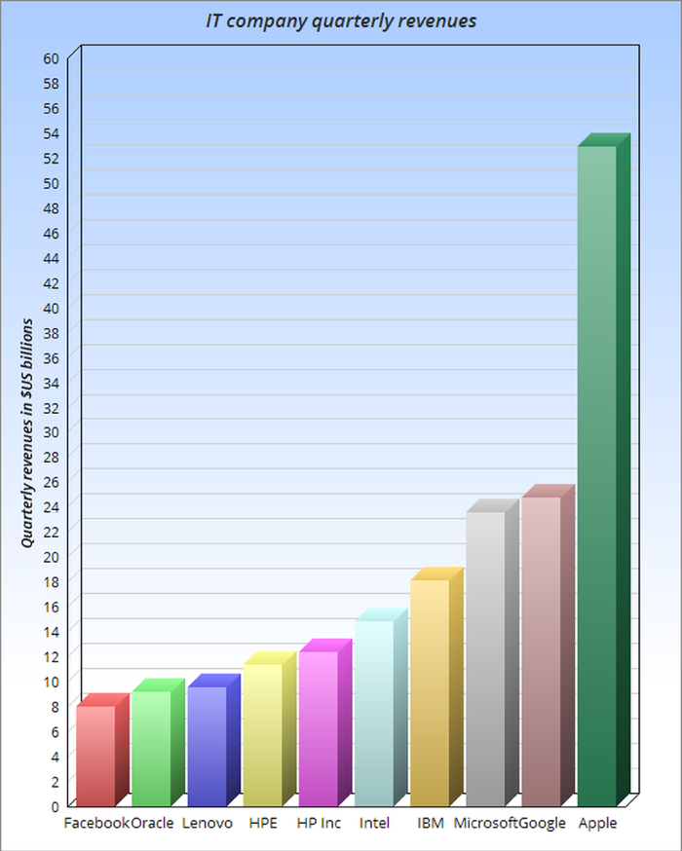
Bar charges consists of a series of horizontal or vertical bars drawn parallel to each other along a scale of measurement. Each bar can represent a different item or the same item at different times, and the scale can be either a scale of percentage or one of absolute quantities. Therefore, bar graphs are useful for showing comparisons between the figures for the same item for different periods of time or for different items for the same period of time.

Slide 52
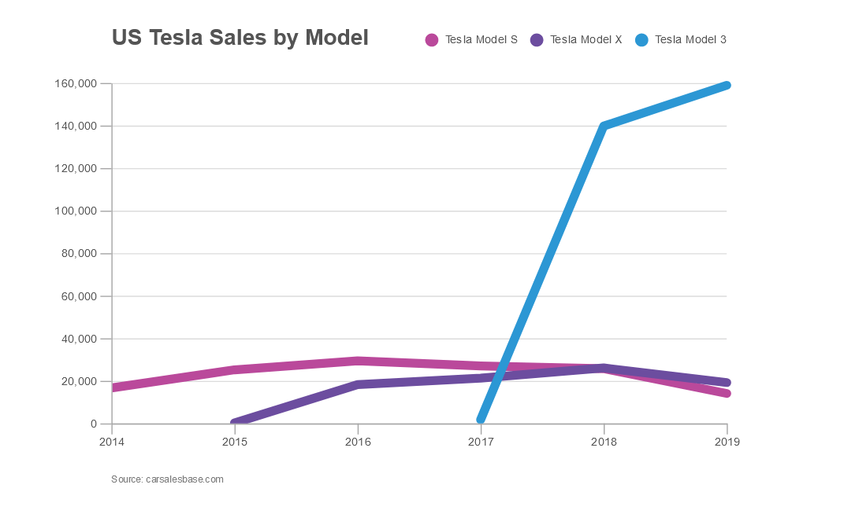
Line graphs (or line charts) are best when you want to show how the value of something changes over time or compare how several things change over time relative to each other. Whenever you hear that key phrase “over time,” that’s your clue to consider using a line graph for your data.
Line graphs are common and effective charts because they are simple, easy to understand, and efficient. Line charts are great for: comparing lots of data all at once, showing changes and trends, highlighting anomalies within and across data series.

Slide 53
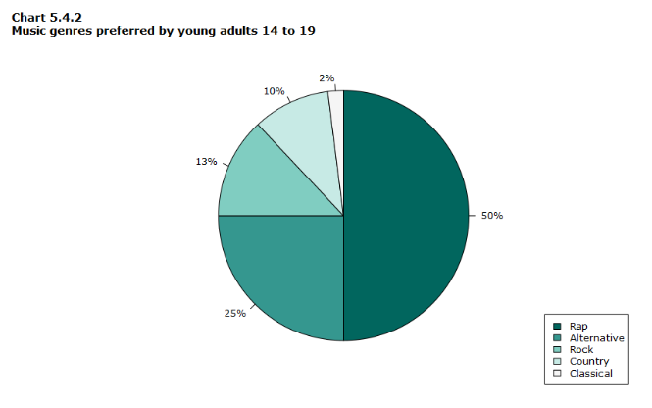
A Pie Chart is a circular graph that is divided into sections that are proportional to the data they represent. The size of each slice of the pie is proportional to the size of the group as a whole. The entire "pie" represents 100% of a total, while the "slices" represent parts of the whole.
Pie charts are handy because they give you an immediate visual representation of your data. They’re easy to understand, as the different coloured sections make it instantly obvious how each section compares to the others. It allows the viewer to see a data comparison at a glimpse, allowing them to do an immediate analysis or quickly comprehend details.

Slide 54
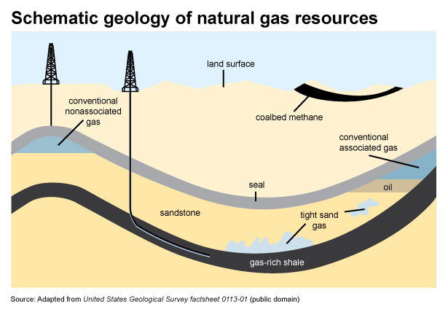
A diagram is a drawing, image, or sketch that is used to help the reader visualize what the author is describing in the text. A diagram gives the reader a picture of how a process or relationship works. Our brains are designed to process information visually. We can see a pattern much more easily than a list of numbers.
Pictures are easier for our brains to comprehend than words. The picture superiority effect ensures we remember graphical information more readily than anything that we read. Diagrams can be used for different reasons, such as to show part of a whole, steps of a process, and relationships.

Slide 55
Activity 3. Translate the following words and word combinations:
Відеозапис, широкі цілі, характер даних, швидкий доступ, висновки, аудиторія,шкала вимірювання, підказка для розгляду, обробляти інформацію, колонки та рядки.
Activity 4. Give the answers to the following questions:
What are the benefits and problems of bringing visuals into a presentation?
What does influence the choices of how to represent data? Why?
What do graphs help illustrate?
What might make you consider using a line graph for your data. Why?
How does the use of a diagram in a presentation help your audience?
Activity 5. Which of the adverbs in the box below describe?
significantly sharply | rapidly steadily | slightly gradually | considerably marginally

Slide 56
Activity 6. Complete this table with the noun forms of the verb:
Past simple verb | Noun | Past simple verb
Rose Fell Declined Soared grew |  | Increased decreased dropped recovered jumped
Activity 7. Make up the word combination with the following words.
Adjectives: sharp/rapid/ huge/ dramatic/ substantial/considerable/ (in)significant/ slight/small/ minimal/ modest/massive.
Nouns: increase / rise / grow / / climb / exceed / decrease / drop / fall / decline / plummet / halve / plunge.
Verbs: to go up/ to rise/to reach a peak/to peak/to reach its highest level/to bottom out/to sink to a though/to go down.
Adverbs: suddenly/sharply/steeply/significantly/considerably/gently/gradually/slightly/
steadily/ modestly/ a little.

Slide 57
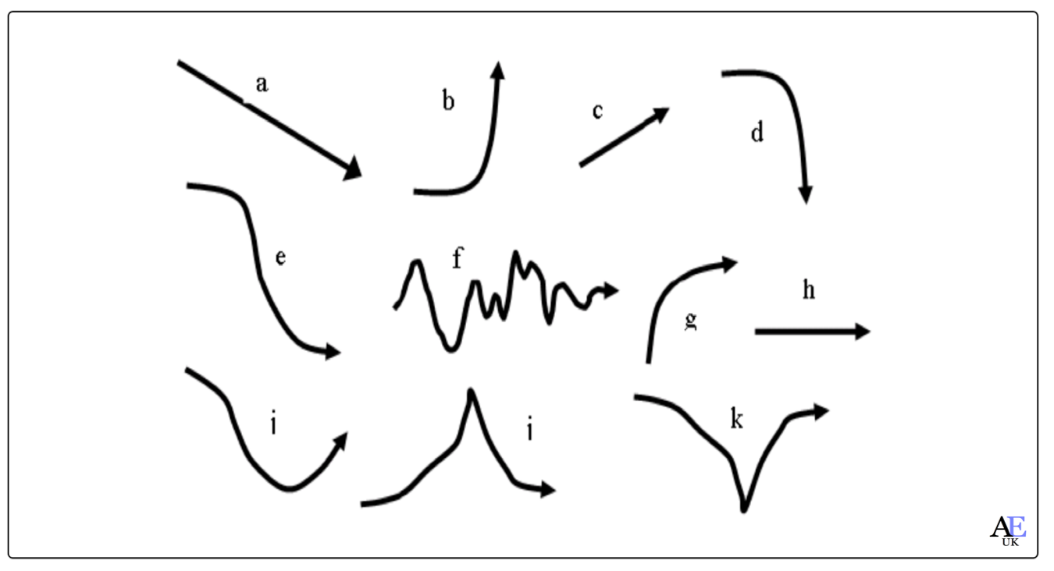
Activity 8. Study the verbs. Use them and the word combination from Task 7 to describe the images:
VERBS TO DESCRIBE INCREASES | VERBS TO DESCRIBE DECREASES | VERBS TO DESCRIBE BIG INCREASES | VERBS TO DESCRIBE BIG DECREASES
doubled, went up, grew, improved, increased, rose | declined, decreased, dropped, went down, halved | jumped, rocketed, shot up, surged, soared | plunged, plummeted

Slide 58
Activity 9. Tell about one of the following types of the diagram.
Mind map Quadrant chart Venn diagram Circle diagram Tree diagram Pyramid chart | Funnel chart Roadmap Flowchart Fishbone diagram Quantitative diagram

Slide 59
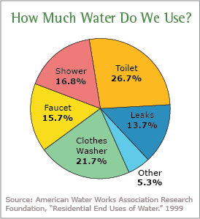
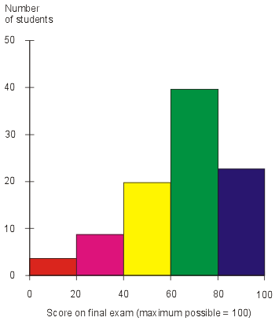
Activity 10: Describe the graphs using the following phrases:
Have a look at this chart (British). / Take a look at this diagram (American). I'd like you to look at this drawing. Let’s look more closely at… The graph represents/illustrates/compares/…. The picture shows/gives information about… What I’d like to point out here is… First, let me explain the graph. | I'd like us to look at this part of the graph in more detail. I'd like to point out that As you can see … I'd also like to draw your attention to … If you look at it more closely, you'll notice You can see that different colours have been used to indicate…

Slide 60
Activity 11. Translate the following sentences:
After Christmas, revenue declined dramatically.
Total income rose steadily in 2013.
There was a steady increase in sales during the last quarter.
There was a slight climb in company revenue during 2014.
We had a plunge in revenue after the collapse in oil prices.
In the period from September to November, the profits increased significantly reaching a peak of 10 million.
Profits are expected to recover in the current financial year.
The number of bike commuters increased sharply between 2019 and 2021.
There have been dramatic cuts in the level of spending on the elderly.
Between 1990 and 2000, there was a drop of 15%.

Slide 61
Task 12. Do a quiz on preposition:
1. Following this, the number then fell … a low of 20 per month.
to b. at c. by d. on
2. There is a sharp increase … traffic levels from 8am to 9am
to b. at c. in d. on
3. From 2001 to 2010, the price of electricity has increased … 20%
to b. at c. by d. on
4. There has been a decrease … the consumption of sugar this decade.
in b. at c. by d. on
5. Profits fell … 10%, from 2000 to 1800.
in b. at c. by d. on
6. The number of students fell … a low of 1800 in 2003.
to b. at c. by d. on
7. The figure rose steadily … the four years between 1997 and 2001.
during b. at c. by d. in
8. Cases of AIDS shot … from 2400 in 1996 to 4000 in 2003.
up b. at c. by d. on
9. The production of hybrid and electric cars ended … 400,000 in 2016.
to b. at c. by d. on
10. In 2018, consumption of this type of fast food fell … 400,000 portions
to b. at c. by d. on

Slide 62
Activity 13. Give each group of phrases a title from the box below:
highlighting important information introducing bad news introducing a contrast introducing the graph
showing results showing a sequence
The above graph shows | B. This is in contrast to On the other hand However | C. Unfortunately
D. This was followed by This was preceded by This led to | E. As a result This has resulted in Consequently | F. Most importantly

Slide 63
Activity 13. Study the graph. Read the description and fill in the gaps:

Slide 64
Trends in GDP & Air Cargo growth rates
(1)______________. (2) ________________ trends in GDP (Gross Domestic Product) and Air Cargo growth rates. (3) __________the rates of GDP, domestic cargo and international freight respectively. (4)_____________. (5)______________, the slowdown in cargo seems to be preceding the slowdown of the economic growth. That is why air cargo sector is known to be the barometer of the economic health of a country. (6) ________________ India’s GDP at constant prices has almost quadrupled in the last two decades. (7) ______________ of 5.6% in the 1990s (8) ________________ of 7.7% in the first decade of 2000, the growth journey has excited many investors both in India and abroad. The latter part of 2000s particularly in the period 2008-09 to 2010-11 recorded (9) ________________ of 8.3%. (10) ___________ in 2011-12 is expected to be temporary as the fundamentals of Indian economy are evaluated to be strong with high investment rate of 36% and growing domestic demand. Analysts forecast the Indian GDP to be growing at 7.5% in 2012 and at 8.1% subsequently till 2016.
If you look at the lines more closely, you'll notice that
The graph shows
Let’s now look at the next slide
I'd like you to focus your attention on the significance of these figures here.
The current slowdown
As you can see,
From a slower average annual growth rate …
to a moderately faster average annual growth rate…
The blue, red and green lines on the graph indicate
an average annual growth

Slide 65

UNIT 8
MAKING PRESENTATIONS

Slide 66
Activity 1. Read and translate the following words and word combinations. Explain their meaning in English:
professional environment, face-to-face environment, virtual environment, to succeed in convincing the audience, point of view, to appeal to the intellect and emotions, the sole aim, information on the background, a single concise statement, to reinforce the main idea, to diminish a speaker's credibility, to speak flawlessly, a tiny inaccuracy, excessive details.
Activity 2. Read the text and discuss it. Write a synopsis of the text in five sentences.
At some point in your future careers, you will be called upon to give a presentation to your boss, colleagues, perhaps even customers. Although this may seem scary, it is also an opportunity to prove your knowledge and communication skills. Public speaking skills are important in a professional environment. University is the perfect time to develop and perfect this skill. Knowing how to plan and execute a well-developed presentation in a face-to-face or virtual environment is a skill that will make your future employers take notice.
The dictionary definition of presentation is “an event at which a new product or idea is described and explained”. It is therefore essential for students looking for employment to develop skills, language and techniques needed to present in public with confidence if they wish to succeed in their careers. Presentations are high-risk, high-visibility activities. Success and failure can have a significant effect on your career. The ability to speak English is no guarantee that you can present in English. Presenters need presentation skills and a level of professionalism.
Presentations can be presented for different purposes. Before getting ready with a presentation, it is necessary to have a clear idea regarding the purpose of the presentation. There are 5 most common types of presentations:

Slide 67
Informative
You might need to create an informative presentation to explain important details tied to a topic before an audience. This type of presentation might be brief, with essential information. Such a presentation is usually based on facts and avoids too many complicated details and assumptions.
Examples: Class lectures, research findings, technical information, results from experiments, etc.
Persuasive
A persuasive presentation is geared towards convincing the audience to believe a specific point of view. Such a presentation might conclude with a call to action.
Examples: Product demos, sales pitch, investor pitch, presentations on social issues, debates, etc.
Instructional
Instructional presentation might be to provide an audience with instructions, such as regarding a process, or the use of a product. Such presentations are usually longer, as they require demonstrations and detailed explanation of each aspect of the topic.
Examples: Tutorials for using a software, device or machine, employee orientation presentations, etc.
Arousing
This type of presentation is meant to make the audience think about a certain topic. This can be to appeal to the intellect and emotions of the audience to point them towards a certain point of view or to start a social debate.
Example: Religious speech, motivational presentation, etc.
Decision Making
Some presentations are conducted with the sole aim of providing facts and figures to help the audience reach a decision.
Examples: Business meetings, presentation about legislation and laws, a SWOT analysis presentation, etc.

Slide 68
Preparing a presentation can be an overwhelming experience if you allow it to be one. The strategies and steps below are provided to help you break down what you might view as a large job into smaller, more manageable tasks.
Step 1: Analyze your audience
The first step is to learn more about the audience to whom you'll be speaking. It's a good idea to obtain some information on the backgrounds, values, and interests of your audience so that you understand what the audience members might expect from your presentation.
Step 2: Select a topic
Select a topic that is of interest to the audience and to you. It will be much easier to deliver a presentation that the audience finds relevant, and more enjoyable to research a topic that is of interest to you.
Step 3: Define the objective of the presentation
Once you have selected a topic, write the objective of the presentation in a single concise statement. The objective needs to specify exactly what you want your audience to learn from your presentation.
Step 4: Prepare the body of the presentation
After defining the objective of your presentation, determine how much information you can present in the amount of time allowed. Also, use your knowledge about the audience to prepare a presentation with the right level of detail. You don't want to plan a presentation that is too basic or too advanced. The body of the presentation is where you present your ideas. To present your ideas convincingly, you will need to illustrate and support them. Strategies to help you do this include the following:
present data and facts
read quotes from experts
relate personal experiences
provide vivid descriptions
And remember, as you plan the body of your presentation it's important to provide variety. Listeners may quickly become bored by lots of facts, or they may tire of hearing story after story.

Slide 69
Step 5: Prepare the introduction and conclusion
Once you've prepared the body of the presentation, decide how you will begin and end the talk. Make sure the introduction captures the attention of your audience and the conclusion summarizes and reiterates your important points. In other words, "Tell them what you're going to tell them. Tell them. Then, tell them what you told them."
During the opening of your presentation, it's important to attract the audience's attention and build their interest. If you don't, listeners will turn their attention elsewhere and you'll have a difficult time getting it back. Strategies that you can use include the following:
begin your speech with some amazing facts
begin your speech with a well-known quotation
address the audience’s needs and concerns by telling them what benefits they will gain from listening to you
ask questions to stimulate thinking
share a personal experience
use a joke or humorous story
project a cartoon or colorful visual
make a stimulating or inspirational statement
During the conclusion of your presentation, reinforce the main ideas you communicated. Remember that listeners won't remember your entire presentation, only the main ideas. A good summary reminds your audience about what you said and helps them to remember your information.

Slide 70
Activity 3. Answer the following questions:
What do you think students can learn from giving presentations?
What can you help a student to feel more confident?
What is the object of any presentation?
What is the purpose of the conclusion?
Think about what else will make a spoken presentation good.
Activity 4. The three main stages of any presentation are: A) The Beginning B) The Middle C) The Ending y . Decide which of the following phrases below would you use at the different stages of your presentation? Mark your replies with A,B,C.
To sum up… I’m afraid I can’t answer … Let’s move on to … The purpose of my talk is … I’d like to conclude… |  | In conclusion… Did you know that…? I would like to talk about… Thanks for the opportunity … To summarize the main … |  | After that we will look at … What was the reason for …? I have divided my talk into three… Let us leave that and … Thank you all for patiently listening …

Slide 71
Activity 5. The following text deals with a very important aspect of presentations: ‘The Audience Questions’. Fill up the blank spaces in the text with the help of the words from the box. You will need to use some of these words more than once.
Audience questions are important _________ any presentation. You can have two policies __________ this issue. You may either allow the audience _________ask you questions anytime during the course __________ your presentation or you may request your audience to hold questions ___________ the end. Questions are an excellent indicator _________ the extent of involvement of the audience ___________ your presentation. If you choose the first option __________ inviting the questions during the presentation, you will have the opportunity ________ clarify doubts as you go along and ensure that your point has been understood. But if you save them ____________ the end you will get through the material uninterrupted. It is up to you __________ make the decision. Whatever you do, make sure you stay _________ time! If your allotted time is 10 minutes, do not exceed it. This way you can make sure that the audience remains engaged.
of to until in on

Slide 72
Activity 6. Look at the presentation openings and divide them under three headings:
What do you think each presentation was about?
1. Did you know that Japanese companies spend four times more on entertaining clients in a year than the entire GDP of Bulgaria? 40 billion dollars, to be precise, You know, that's twice Colombia's total foreign debt. You could buy General Motors for the same money.
2. Suppose your advertising budget was cut by 99% tomorrow. How would you go about promoting your product?
3. According to the latest study, by 2050 only one in every four people in Western Europe will be going to work. And two will be old age pensioners.
4. You know, R&D is 90% luck. When I think about creativity, I'm reminded of the man who invented the microwave oven. He spent years messing around with radar transmitters, then noticed the chocolate in his pocket was starting to melt!
5. Statistics show that in the last ten years more people have legally emigrated to the United States than to the rest of the world put together - about half a million of them a year, in fact. Now, over ten years, that's roughly equivalent to the population of Greece.
6. Have you ever wondered why it is that Americans are easier to sell to than Europeans? And why nine out of ten sales gurus are American? You have? Well, if I could show you what stops Europeans buying, would you be interested?
7.1 read somewhere the other day that the world's highest paid executive works for Disney and gets $230 million a year. Now that's about $2000 a minute! That means he's currently making more money than Volkswagen.
8. How many people here this morning hate going to meetings? Just about everybody, right? Well, imagine a company where there were never any meetings and everything ran smoothly. Do you think that's possible?
9. Have you ever been in the situation where you've had to negotiate with the Japanese? 1 remember when I was working in Nagoya and everybody had told me the Japanese don't like saying no. So in meetings 1 just kept saying ~eah to everything. And they hated it. It turned out yeah sounds like no in Japanese!
PROBLEMS | AMAZING FACTS | STORIES

Slide 73
Activity 7. Below you will find a few ways of stating the purpose of your presentation. Complete them using the words given.
OK, let's get started. Good morning, everyone. Thanks for coming. I'm (your name). This morning I'm going to be:
showing talking taking reporting telling
1. .......... to you about the videophone project.
2. .......... you about the collapse of the housing market in the early 90s.
3. .......... you how to deal with late payers.
4. .......... a look at the recent boom in virtual reality software companies.
5. .......... on the results of the market study we carried out in Austria.
So, I'll begin by:
making outlining bringing giving filling
1. .......... you in on the background to the project.
2. .......... a few observations about the events leading up to that collapse.
3. .......... company policy on bad debt.
4. .......... you an overview of the history of VR.
5. .......... you up-to-date on the latest findings of the study.
. . . and then I'll go on to:
put discuss make highlight talk
1. .......... what I see as the main advantages of the new system.
2. .......... the situation into some kind of perspective.
3. .......... you through our basic debt management procedure.
4. .......... detailed recommendations regarding our own R&D.
5. .......... in more depth the implications of the data in the files in front of you.

Slide 74
Activity 8. Cross out the verbs which do not fit in the following presentation extracts.
1. First of all, I'd like to preview / overview / outline the main points of my talk.
2. Perhaps I should start off by pointing / stressing / reminding that this is just a preliminary report. Nothing has been finalized yet.
3. But later I will, in fact, be putting forward / putting out / putting over several detailed proposals.
4. One thing I'll be dealing with / referring / regarding is the issue of a minimum wage.
5. And I'll also be asking / raising / putting the question of privatization.
6. So, what we're really driving at / aiming at / looking at are likely developments in the structure of the company over the next five to ten years.
7. If we could just draw / focus / attract our attention on the short-term objectives to begin with.
8. The eighteen-month plan, which by now you should've all had time to look at, outlines / reviews / sets out in detail our main recommendations.
9. Basically, what we're suggesting / asking / reviewing is a complete reorganization of staff and plant.
10. I'd now like to turn / draw / focus my attention to some of the difficulties we're likely to face.
11. I'm sure there's no need to draw out / spell out / think out what the main problem is going to be.
12. But we do need to seriously ask / answer / address the question of how we are going to overcome it.
13. The basic message I'm trying to get through / get across / get to here is simple. We can't rely on government support for much longer.
14. Disappointing end-of-year figures underline / undermine / underestimate the seriousness of the situation.
15. And the main conclusion we've thought / got to / come to is that massive corporate restructuring will be necessary before any privatization can go through.

Slide 75
Activity 9. Read the following presentation extracts. First, decide where you could add extra emphasis. Then write in the intensifiers given at the end of the sentence. The first one has been done for you as an example.
l. We're doing extremely well now. But how can we do even better? (extremely, even)
2. The project is underfunded. A (whole, badly)
3. It's obvious that we made a mistake. (pretty, terrible)
4. It works out cheaper to take on casual workers. (actually, much)
5. I'm aware that it's been a disaster from start to finish. (fully, total)
6. I'm certain that we're in a better position now. (one hundred percent, significantly)
7. There's no hope of reaching our targets by the end of phase two. (absolutely, at all)
8. There's been a decrease in demand, and yet sales are up on last year. (dramatic, well)
9. We shouldn't be neglecting a lucrative market. (really, such, highly)
10. There's no chance of making progress. (absolutely, whatsoever, real)
11. It's going to be too expensive to re-equip the factory. (just, far, entire)
12. It's difficult to know whether the figures are going to improve. (just, so, actually)
13. We can't be expected to manage on a tiny budget. It's ridiculous. (really, such, just)
14. It's too late to do anything about it. (actually, far, at all)

Slide 76
Activity 10. Below are some well-known sayings. Present them, paying particular attention to pausing, stress and the rise and fall of your voice. Remember that in a presentation it is better to vary your voice too much rather than too little.
1. Luck is what happens when preparation meets opportunity.
2. The easier it is to do, the harder it is to change.
3. Teamwork is twice the results for half the effort.
4. Don't let what you can't do interfere with what you can.
5. Humor is always the shortest distance between two people.
6. Anyone can make a mistake, but to really mess things up requires a computer.
7. People always have two reasons for doing things: a good reason and the real reason.
8. People who think they know it all are a pain in the neck to those of us who really do.
9. An expert is someone who knows more and more about Iess and Iess until he knows everything about nothing.
10. The human brain starts working the moment you are born and doesn't stop until you stand up to speak in public.

Slide 77
Activity 11. Look at the following presentation extracts. Each contains a statement which can have two completely different meanings, depending on how you say it, The meanings are explained after each one. Chunk each statement according to what it means.
la. We attended the conference on trade tariffs in Japan.
The trade tariffs conference was in Japan.
lb. We attended the conference on trade tariffs in Japan.
The conference was about Japanese trade tariffs.
2a. Those who sold their shares immediately made a profit.
But those who didn't sell immediately, didn't make a profit.
2b. Those who sold their shares immediately made a profit.
All those who sold their shares made an immediate profit.
3a. The Germans who backed the proposal are pleased with the results.
The Germans backed the proposal and are pleased with the results.
3b. The Germans who backed the proposal are pleased with the results.
But the Germans who didn't back it, aren't.
4a. It's time to withdraw the economy models which aren't selling.
All the economy models should be withdrawn because they aren't selling.
4b. It's time to withdraw the economy models which aren't selling.
So that we can concentrate on the economy models which are selling.

Slide 78
Activity 12. Study the following well-known quotations and try to say them so that they have an impact. Mark the pauses with a slash (1) and highlight the words you want to stress.
1. "People can be divided into three groups: those who make things happen, those who watch things happen and those who ask 'What happened!"' John Newbern
2. "This is not the end. It is not even the beginning of the end. But it is, perhaps, the end of the beginning." Winston Churchill
3. "Coming together is a beginning; keeping together is progress; working together is success." Henry Ford
4. "Organizations don't have new ideas. Teams don't have new ideas. Individuals have new ideas. That's why you come first." John Adair
5. "There are three types of lies: lies, damned lies and statistics." Benjamin Disraeli
6. "The other man's word is an opinion; yours is the truth; and your boss's is law." Anonymous
7. "Most presentations have three basic stages: tell them what you're going to tell them; tell them; tell them what you told them." Anonymous
8. "The old believe everything; the middle-aged suspect everything; the young know everything." Oscar Wilde
Activity 13. What is your opinion?
an interesting topic correct information explanations where necessary suitable length (not too long) right level of language for the audience a clear introduction and conclusion | a lively and friendly tone a clear voice that everyone can hear a good pace (not too fast, not too slow) appropriate body language eye contact with the audience jokes

Slide 79
Activity 14. Read and translate. Give your opinion to each statement.
Characteristics of a Good/Effective Presentation
The presentation ideas should be well adapted to your audience. Relate your presentation message/idea to the interests of the audience. A detailed audience analysis must be made before the presentation, i.e., an analysis of the needs, age, educational background, language, and culture of the target audience. Their body language instantly gives the speaker the required feedback.
A good presentation should be concise and should be focused on the topic. It should not move off-track.
A good presentation should have the potential to convey the required information.
The fear should be transformed into positive energy during the presentation. Be calm and relaxed while giving a presentation. Before beginning, wait and develop an eye contact with the audience. Focus on conveying your message well and use a positive body language.
To communicate the desired information, the speaker should use more of visual aids such as transparencies, diagrams, pictures, charts, etc. Each transparency/slide should contain limited and essential information only. No slide should be kept on for a longer time. Try facing the audience, rather than the screen. The speaker should not block the view. Turn on the room lights else the audience might fall asleep and loose interest. Organize all the visuals for making a logical and sound presentation.
A good presentation must be planned. The speaker must plan how to begin the presentation, what to speak in the middle of presentation and how to end the presentation without losing audience interests at any point of time.
Rehearse and practice the presentation. This will help the speaker to be more confident and self-assured. The more the speaker rehearses the better the presentation turns to be.
The speaker should encourage more questions from the audience. He should be honest enough to answer those questions. If any biased question is put forth by the audience, rearticulate it before answering.
Summarize the presentation at the end. Give final comments. Leave a positive impact upon the audience.
The speaker must have a presentable appearance while giving a presentation. The speaker should stand with feet far apart maintaining a good balance. He must use confident gestures. He must use short and simple words.
Try to gain and maintain audience interest by using positive quotes, humour, or remarkable fact.
The speaker must be affirmative and optimistic before giving presentation. He should ensure all tools and equipments to be used in presentation are working well.
The speaker must state the objectives of the presentation at beginning of the presentation.

Slide 80
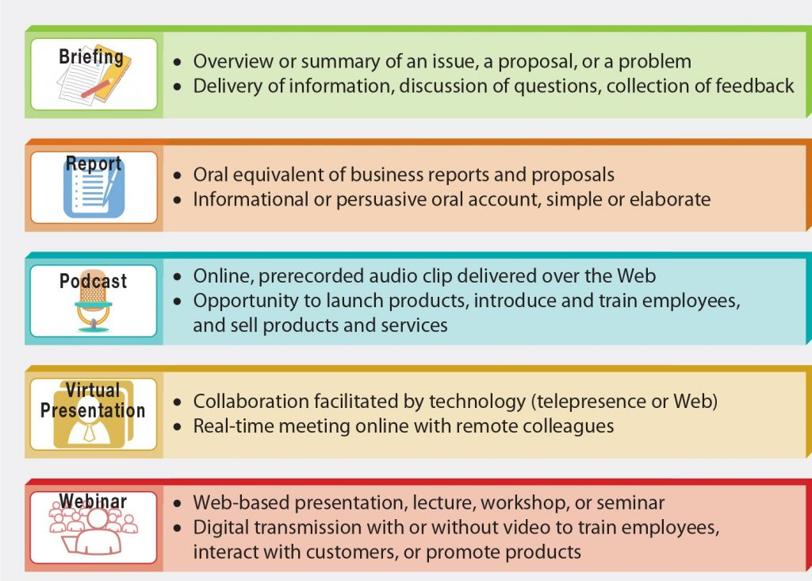
Activity 15. Study the table. Tell the difference between the different types of business presentations. Match the types of presentations with their definitions.

Slide 81
Podcast Reports Briefings Webinar Virtual presentation | developed by collaborative teams via digital technologies. may or may not include a video to deliver a web-based lecture or workshop. are a concise overview made to a project team or department. provide regular ongoing updates of routine company business to both internal and external audiences. a web-based audio recording to launch company products or services.

Slide 82
Activity 16. Complete the following sentences with the correct word.
1. First of all, I’d like to … the main points of my talk.
a) preview b) overview c) outline
2. So, what we’re really … are likely developments in the structure of the company over the next five to ten years.
a) driving at b) aiming at c) looking at
3. The eighteen-month plan, which by now you should have all had time to look at, … in detail our main recommendations.
a) outlines b) reviews c) sets out
4. And the main conclusion we’ve … is that massive corporate restructuring will be necessary before any privatization can go through.
a) thought b) got to c) come to
5. I’d like to … yours attention to some of the difficulties we’re likely to face.
a) turn b) draw c) focus
6. I have the figures for the last three months to … to you.
a) have b) introduce c) present
7. I’ve tried to … our difficulties into some kind of perspective.
a) put b) fill c) bring
8. I’m going to be … at the arguments against networking.
a) showing b) telling c) looking

Slide 83
Activity 17. These are some expressions used in the presentation. Put them in a logical order.
There will be time at the end for questions.
b. I will then look at some of the challenges
c. I'm here to talk about the “twines” market.
d. I'll finish by looking at some case studies.
e. I will begin by outlining an overall profile.
f. To start off, let me ask you ...
g. Good morning, everyone.
h. I guess the best way to answer that question is ...
i. If you look at this graph, you'll notice ...
k. My name is Janet Wilkins.
Activity 18. Underline the correct words.
1. First of all/after all, I’d like to thank you for inviting me here to speak to you this morning. 2. I’ll be talking today about robotics, and anyway/in particular their commercial exploitation. 3. Especially/Clearly there’s huge interest in the subject. 4. As far as the general public is concerned/concerning the general public, Sony Corporation thinks that the best way place to launch the robot revolution is home entertainment. 5. Especially/Furthermore home entertainment is likely to be the biggest market eventually/at last. 6. As a matter of fact/Moving on to all the leading players are investing tens of millions of dollars in the development of personal robots. 7. I mean/As a result progress has been rapid. 8. On the other hand/At the end, it’s clear that the development of ‘robosapiens’ will take longer, a lot longer. 9. Nevertheless/In general it’s clear that in terms of competition between countries Japan leads in robotics at the moment. 10. So, in fact/To sum up, I’ve tried to show you how I believe we’re entering a new age, the age of the robot, and it’s an age that’s full of business opportunities.

Slide 84

UNIT 9
CRITICALLY REVIEWING THE LITERATURE

Slide 85
Activity 1. Check up the pronunciation of the following words. Learn them.
Allegiance biased coherent cohesive collation enhance explicit implicitly indent newsworthy tertiary | вірність, відданість, лояльність необ’єктивний, тенденційний логічно послідовний, узгоджений зв’язний порівняння, співставлення збільшувати, посилювати, покращувати явний, точний, ясний неявно, імпліцитно, повністю, цілком робити абзац/відступ вартий висвітлення у пресі, важливий (той) що належить до третього рангу/класу, третьорядний
Activity 2. Make up word combinations with the adjectives given in task 1.

Slide 86
Activity 3. Read the text and discuss it. Write a synopsis of the text in five sentences.
CRITICALLY REVIEWING THE LITERATURE
1. Knowledge doesn’t exist in a vacuum, and your work only has value in relation to other people’s. Your work and your findings will be significant only to the extent that they’re the same as, or different from, other people’s work and findings.
You therefore need to establish what research has been published in your chosen area and try to identify any other research that might currently be in progress. The items you read and write about will enhance your subject knowledge and help you to clarify your research question(s) further. This process is called critically reviewing the literature.
2. Your critical literature review will form the foundation on which your research is built. Its main purpose is to help you to develop a good understanding and insight into relevant previous research and the trends that have emerged. Your review also has a number of other purposes:
• to help you to refine further your research question(s) and objectives;
• to highlight research possibilities that have been overlooked implicitly in research to data;
• to discover explicit recommendations for further research. These can provide you with a superb justification for your own research question(s) and objectives;
• to help you to avoid simply repeating work that has been done already;
• to sample current opinions in newspapers, professional journals, thereby gaining insights into the aspects of your research question(s) and objectives that are considered newsworthy;
• to discover and provide an insight into research approaches, strategies and techniques that may be appropriate to your own research question(s) and objectives.

Slide 87
3. As you begin to find, read and evaluate the literature, you will need to think how to combine the academic theo­ries and ideas it contains to form the critical review that will appear in your project report. This will need to discuss critically the work that has already been undertaken in your area of research, and reference that work. It will draw out the key points and trends and present them in a logical way. In doing this you will provide readers of your project report with the necessary background knowledge to your research question(s) and objectives and establish the boundaries of your own research. It will also enable the readers to see your ideas against the background of previous published re­search in the area. This does not necessarily mean that your ideas must extend, follow or approve those set out in the literature. You may be highly critical of the earlier research and seek to discredit it. However, if you wish to do this you must still review the literature, argue clearly why it is problematic, and then justify your own ideas.
In writing your critical review you will therefore need:
• to include the key academic theories within your chosen area;
• to demonstrate that your knowledge of your chosen area is up to date;
• to show how your research relates to previous published research;
• to assess the strengths and weaknesses of previous work and take these into account in your arguments;
• to justify your arguments by referencing previous research;
• through clear referencing, to enable those reading your research report to find the original work you cite.
4. Within the context of reviewing the literature, the term ‘critical’ refers to the judgement you exercise. It there­fore describes the process of providing a detailed and justified analysis of and commentary on the merits and faults of the key literature within your chosen area. This means that, for your review to be critical, you should:
refer to work by recognized experts in your chosen area;

Slide 88
• consider and discuss work that supports and work that opposes your ideas;
• make reasoned judgements regarding the value of others’ work to your research;
• support your arguments with valid evidence in a logical manner;
• distinguish clearly between fact and opinion.
5. Although there is no single structure that your critical review should take, it is useful to think of the review as a funnel in which you:
• start at a more general level before narrowing down to your specific research question(s) and objectives;
• provide a brief overview of key ideas;
• summarize, compare and contrast the work of the key writers;
• narrow down to highlight the work most relevant to your research;
• provide a detailed account of the findings of this work;
• highlight the issues where your research will provide fresh insights;
• lead the reader into subsequent sections of your project report, which explore these issues.
Whichever way you structure your review you must demonstrate that you have read, understood and evaluated the items you have located. The key to writing a critical literature review is therefore to link together the different ideas you find in the literature to form a coherent and cohesive argument, which set in context and justify your research. Obvi­ously, it should relate to your research question and objectives. It should show a clear link from these as well as a clear link to the empirical work that will follow.

Slide 89
6. The literature sources available to help you to develop a good understanding of and insight into previous re­search can be divided into three categories: primary (published and unpublished), secondary, and tertiary. In reality these categories often overlap: for example, primary literature sources including conference proceedings can appear in journals, and some books contain indexes to primary and secondary literature.
Primary literature sources (also known as grey literature) are the first occurrence of a piece of work. They include published sources such as reports, conference proceedings, theses. They also include unpublished manuscript sources such as letters, and memos.
Secondary literature sources such as books and journals are the subsequent publications of primary literature. These publications are aimed at a wider audience. They are easier to locate than primary literature as they are better covered by the tertiary literature.
Tertiary literature sources, also called search tools, are designed either to help to locate primary and secondary literature or to introduce a topic. They therefore include indexes and abstracts as well as encyclopedias and bibliog­raphies.
Your use of these literature sources will depend on your research questions and objectives. For some research pro­jects you may use only tertiary and secondary literature; for others you may need to locate primary literature as well.
7. It is important that you plan the literature search carefully to ensure that you locate relevant and up-to-date literature. This will enable you to establish what research has been previously published in your area and to relate your own research to it. Time spent planning will be repaid in time saved when searching the literature. As you start to plan your search, you need to beware of information overload! Before commencing your literature search you should under­take further planning by:
• defining the parameters of your search; • generating key words and search terms;
• discussing your ideas as widely as possible. • Techniques to help you in this include brainstorming and relevance trees.

Slide 90
8. Once obtained, the literature must be evaluated for its relevance to your research questions and objectives. The following questions provide a checklist to help you in this process.
- How recent is the item?
- Have you seen references to this item (or its author) in other items that were useful?
- Does the item support or contradict your arguments? For it will probably be worth reading!
- Does the item appeared to be biased? Even if it is it may still be relevant to your critical review!
- What are the methodological omissions within the work? Even if there are many it still may be of relevance!
- If the precision sufficient? Even if it is imprecise, it may be the only item you can find and so still of relevance!
Your assessment of whether you have read enough amount is even more complex. It is impossible to read eve­rything, as you would never start to write your critical review. Yet you need to be sure that your critical review dis­cusses what research has already been undertaken and that you have positioned your research project in the wider con­text, citing the main writers in the field. One clue that you have achieved this is when further searching provides mainly references to items you have already read. You also need to check what constitutes an acceptable amount of reading, in terms of both quality and quantity, with your scientific advisor.
Activity 4. Skim the text. Find an appropriate heading for each paragraph.
a. planning the literature search b. definition of critical literature review
c. evaluating the literature found d. what is meant by critical
e. the purpose of the critical review f. the structure of the critical review
g. the content of the critical review h. literature sources

Slide 91
Activity 5. Answer the questions.
1 What is the purpose of the critical literature review?
2. What items should you include in your critical review?
3. What literature sources should you use when writing your critical review?
4. How can you evaluate the relevance and sufficiency of the literature found?
Activity 4. 6. Match terms in column A with their definitions in column B
A | B
1) critical literature review | a) an alphabetical list of something such as subjects or names at the back of a book, that shows on which page they are mentioned
2) key word | b) the first occurrence of a piece of work, including published sources such as government white papers, and unpublished sources such as letters, memos and committee minutes
3) tertiary literature source | c) detailed and justified analysis and commentary of the merits and faults of the literature within a chosen area, which demonstrates familiarity with what is already known about your research topic
4) grey literature | d) journal in which the articles have been evaluated by academic peers prior to publication to assess their quality and suitability
5) index | e) journals produced by a professional organisation for its members, often containing articles of a practical nature related to professional needs
6)professional journal | f) source designed to help locate primary and secondary literature, such as an index, abstract, or bibliography
7) references | g) article that contains both a considered review of the state of knowledge in a given topic area and pointers towards areas where further research needs to be undertaken
8)refereed academic journal | h) International Standard Serial Number, a unique eight-digit number used to identify a print or electronic periodical publication
9) review article | i) bibliographic details of all items referred to directly in the text
10) ISBN | j) basic term that describes the research questions and objectives which can be used in combination to search the tertiary literature
11) ISSN | k) International Standard Book Number; a unique 9-digit number given to every book that is published

Slide 92

Activity 7. State whether the following statements are true or false.
1. Bibliographic details required to find a journal article normally include the author, year of publication, title of article, title of jour­nal, volume, part/issue, page numbers.
2. Theses can be difficult to locate and, when found, difficult to access as there may be only one copy at the awarding institution.
3 Academic journals are never available on the Internet.
4. While reviewing the literature you do not need to assess the strengths and weaknesses of previous work, including omissions and bias.
5. For your review to be critical you don’t need to make reasoned judgements regarding the value of others’ work to your research.
6. By fully acknowledging the work of others you will avoid charges of plagiarism.

Slide 93
Activity 4. Find Ukrainian equivalents of the English words used in the text.
1) enhance v. | а) судження, підстава
2) emerge v. | б) відбирати зразки, пробувати
3) implicitly adv | в) збільшувати, підсилвати
4) explicit a. | г) складати(документ)
5) justification n. | д) неявно, приховано
6) sample v | е) проявлятись, виникати (про питання, проблему)
7) draw out v. | є) явний, конкретний, повністю висловлений
8) discredit v. | ж) використовувати, користуватись
9) exercise v | з) логічно послідовний, когерентний
10) distinguish v | и) остерігатися
11) reference v. | і) необ’єктивний, тенденційний
12) coherent a. | ї) дискредитувати
13) cohesive a. | й) забезпечити текст посиланнями
14) beware v. | к) відрізнятись
15) biased a | л) зв’язний
16) relevance n. | м) частково співпадати
17) overlap v. | н) значущість, доречність, важливість

Slide 94
Activity 9. Fill in the blanks in the text using the phrases from the box.
a) critically discussing and referencing work b) develop a thorough understanding of and insight into
c) research question(s) and objectives d) primary literature
e) brainstorming and relevance trees f) at a more general level
g) a logically argued way h) following up references in articles you have already read
i) key words and search terms
A critical review of the literature is necessary to help you to 1) previous research that relates to your research question(s) and objectives. Your review will set your research in context by 2) that has already been undertaken, drawing out key points and presenting them in 3) , and highlighting those areas where you will provide fresh insights. It will lead the reader into subsequent sections of your project report. There is no one correct structure for a critical review, although it is helpful to think of it as a funnel in which you start 4) prior to narrowing down to your specific research question(s) and objectives. Literature sources can be divided into three categories: primary, secondary and tertiary. In reality, these categories often overlap. Your use of these resources will depend on your research question(s) and objectives. Some may use only tertiary and secondary literature. For others, you may need to locate 5)_________ as well. When planning your literature search you need:
- to have clearly defined 6)___ ; - to define the parameters of your search;
- to generate 7)________ ; - to discuss your ideas as widely as possible.
Techniques to help you in this include 8) Your literature search will be undertaken using a variety of approaches in tandem. These will include: - searching using tertiary sources and the Internet; - 9) ____________ ; - scanning and browsing secondary literature in your library.
Once obtained, the literature must be evaluated for its relevance to your research question(s) and objectives. This must in­clude a consideration of each item's currency. Each item must be read and noted. Bibliographic details, a brief description of the content and appropriate supplementary information should also be recorded.

Slide 95
Activity 10. Answer the questions.
1. What does the process of critically reviewing the literature involve?
2. What is the main purpose of critical literature review?
3. What other purposes does the review state?
4. What do you need to include in your critical review?
5. Does the review imply that your ideas should extend, follow or approve those set out in the literature?
6. What is meant by ‘critical’ in the context of reviewing the literature?
7. What is the accepted structure of critical review?
8. What three categories can literature sources be divided?
9. What do primary literature sources include?
10. Why are secondary literature sources easier to locate?
11. What are tertiary literature sources designed for?
12. What does planning the literature search include?
13. What parameters of the literature obtained should be assessed?

Slide 96

Task 11. Critically reviewing the literature. Perform the following:
• Consider your research questions and objectives. Use your lecture notes, course textbooks and relevant review articles to define both narrow and broader parameters of your literature search considering language, subject area, geo­graphical area, publication period and literature type.
• Generate key words and search terms using one or a variety of techniques such as reading, brainstorming and relevance trees. Discuss your ideas widely, including with your project tutor and colleagues.
• Start your search using both database and printed tertiary sources to identify relevant secondary literature. Be­gin with those tertiary sources that abstract and index academic journal articles and books. At the same time, obtain relevant literature that has been referenced in articles you have already read.
• Expand your search via other sources such as the Internet and by browsing and scanning.
• Obtain copies of relevant items, read them and make notes. Remember also to record bibliographic details, a brief description of the content and supplementary information on an index card or in your reference database.
• Start drafting your critical review as early as possible keeping in mind its purpose.

Slide 97

Unit 10
SCIENTIFIC COMMUNICATION

Slide 98
Activity 1. Read and learn the words and word combinations.
essential a – неодмінний, обов’язковий, необхідний
derivative a – похідний
to set up v – встановлювати
to hold v – проводити
a topic n – тема
a request n – прохання
to submit v – подавати на розгляд, пропонувати (свою точку зору)
an application n – заявка,
an abstract n – короткий виклад змісту, резюме, уривок, анотація до статті
subject area n – предметна секція, група
a chairmanship n – головування
distinguished scientist n – відомий/видатний вчений
hearings n – слухання
to argue v – сперечатися
to keep abreast v – бути в курсі, не відставати
a workshop n – круглий стіл, семінар
thorough adv – ретельний, ґрунтовний, повний
Activity 2. Make up sentences with the words given in Activity 1

Slide 99
Activity 3. Try to guess the meaning of the following phrases
1. conference — meeting for discussion, exchange of views.
2. symposium — a conference at which a particular topic is discussed by speakers.
3. event — an item in a programme of a scientific gathering, a pro­gramme include, such events as plenary sessions, section meetings, semi­nars, workshops, round-table talks, etc.; a social programme includes such events as dinners, reception excursions, tours, etc.
4. the state of the art — the level or position at a given time, especially at present, of generally accepted and available knowledge, technical achievement in a particular field.
5. seminar — a discussion group on any particular subject.
6. colloquium — a meeting for discussion.
7. workshop — a seminar emphasising exchange of ideas and practical methods.
8. criticism —judgement or opinion on something, remark that finds fault.
9. to keep abreast of (with) — to keep up to date.

Slide 100
Activity 4. Read the text and discuss it. Write a synopsis of the text in five sentences.
SCIENTIFIC COMMUNICATION
Communication is essential for scientific research. Science is a public knowledge and the aim of a scientist is to create, criticize and thus contribute to the progress of ideas. This aim is generally achieved through scientific publications and conferences. Articles in regular scientific journals carry from one research worker to another various discoveries, deductions, speculations and observations which are of common interest. Generally scientific papers are derivative and depend on previous research. References to other research are reflected in citations. A scientist relies on the citations to show the place of his investigation in the whole scientific structure.
Another opportunity to share and exchange opinions and information is national and international conferences and symposia. They play an important role in coordinating scientific research. Usually scientific gatherings are sponsored by the central scientific organizations. An organizational committee is set up which decides where and when a conference should be held. Invitations are sent out to organizations interested in the topics discussed, together with the requests to submit applications and abstracts of papers.
After receiving all necessary materials, the committee publishes a programe of the events. At the conference the participants present their papers and listen to the reports read by others on the latest developments and the state of the art in their field. Papers on general topics are read before all the participants, those dealing with specific problems are presented at group meetings and plenary sessions held in subject areas under the chairmanship of distinguished scientists. After the hearings the discussions follow. Scientists can discuss a given problem with other experts in their field, argue with their scientific opponents, find out the details of some experimental procedures. The materials of conferences and symposia are usually published to allow others to keep abreast of the achievements in science.
Another type of scientific meeting are a laboratory or work-group seminar, colloquium or workshop. The members of the staff and guest-speakers make reviews of the developments in their field and report the progress of their research. The speakers expect thorough discussion and criticism, advice and help of their colleagues. Such personal exchange of views is very essential for any scientist.

Slide 101
Activity 5. Translate the following words and word combinations:
Наукові публікації, відкриття та спостереження, залежати від попереднього дослідження, відображатися у цитатах, обмінюватися думками, програма заходів, слухати доповіді, сперечатися з опонентами, бути в курсі наукових досягнень, персонал, робити огляд, бути важливим.
Activity 6. Read the following statements and comment them:
1. Articles play an important role in coordinating scientific research.
2. Each paper must have an abstract of not more than ten lines to be translated into the other three languages.
3. The list of references should include only publications, which are mentioned in the text.
4. Those who want to attend a scientific conference or symposium are requested by the Organising Committee to register, usually by filling in an official application form.
Activity 7. Put questions to underlined words.
1. The aim of a scientist is to contribute to the progress of ideas.
2. Generally scientific papers depend on previous research.
3. Usually scientific gatherings are sponsored by the central scientific organizations.
4. After receiving all necessary materials the committee publishes a programme of the events.
5. After the hearings the discussions follow.
6. Personal exchange of views is very essential for any scientist.

Slide 102
Activity 8. Translate the following sentences.
1. Науковці обмінюються думками та ідеями через наукові публікації та конференції. 2. Наукові статті публікуються у спеціальних виданнях. 3. У статті вчений посилається на цитати інших науковців, щоб показати місце свого дослідження у загальній структурі. 4. Організаційний комітет відповідає за організацію та проведення конференції. 5. Учасники конференції мають нагоду представити свою статтю та послухати доповіді щодо останніх досягнень у своїй галузі. 6. Зазвичай після слухання доповіді відбувається її обговорення. 7. Опубліковані матеріали конференції дозволяють науковцям бути в курсі останніх
Activity 9. Imagine, that you are the chairman of the conference. What would you say, if
• the speaker is wandering about the point;
• speaking time has been exceeded;
• you want the speaker to speak louder into the microphone (from the seat);
• you want the speaker to restrict their contributions to three minutes;
the speaker's voice is not heard;
• the speaker does not stick top the point;
• the speaker is unknown to you and to other participants;
• one of the conference participants is used to interrupting the speaker.

Slide 103
Activity 10. You are at a conference. Your colleague who is asking questions has a bad command of English. He wants you to repeat and translate the answer given to his question.
1. Yes, I must simply agree with you.
2.1 share your opinion but I want to comment upon the results of your research work.
3.1 certainly agree with many researchers as to the problem discussed.
4. My observations of the problem agree with the observations of the previous speaker.
5.1 share your opinion concerning this problem
6.1 agree with what's been said today but I want to comment on one aspect of the problem.
7.1 must accept your point of view.
8. Unfortunately, you are right.
9. Unfortunately, the problem has not been yet investigated.
Activity 11 . Your colleague from Britain asks you to translate some Ukrainian sentences of the discussion recorded.
1. Я цілком згоден із цим твердженням.
2. Мої спостереження збігаються з вашими.
3. Я вітаю вас із позитивними результатами.
4. Я цілком згоден із попереднім доповідачем.
5. Ви маєте рацію. Результати дуже добрі.
6. Я цілком згоден з попереднім доповідачем.
7. Я мушу прийняти це без жодного сумніву.
8. На жаль, це справді так. Проблема потребує подальшого дослідження.
9. Я погоджуюся з тим, що щойно сказав професор Браун.
10. Я вітаю професора Козловського з результатами його наукових досліджень.
11. Мої спостереження збігаються зі спостереженнями англійських учених.
12. Я, безперечно, згоден з тим, що було сказано професором Рональдом, але я хочу прокоментувати результати дослідження.

Slide 104


Unit 11
PLAGIARISM

Slide 105
accuse | звинувачувати
plagiarism | плагіат
offense | правопорушення
paper | письмова класифікаційна робота (стаття, курсова)
suspect | підозрювати
credit | довіра
intentionally | навмисно
consequence | наслідок
failing grade | низька, погана оцінка
expulsion | виключення (з якоїсь організації)
degree | наукова ступінь
withdraw | анулювати, вилучати
citation | посилання, цитування
acknowledge | визнання, підтвердження
reference | згадування, посилання, виноска
Activity 1. Read and remember the following words and word combinations.

Slide 106
Activity 2. Read the text and discuss it. Write a synopsis of the text in five sentences.
According to the Merriam-webster dictionary, the verb “to plagiarize” means: “to steal and pass off (the ideas or words of another) as one’s own: use (another’s production) without crediting the source”. The inclusion of the word “steal” in this definition, includes instances when another’s ideas or words are intentionally used without crediting the source. Even accidentally using another’s ideas or words without proper citation, due to carelessness, falls under this definition since your work tries to “pass off” another’s work as your own. In our tech-forward culture, the simple act of copy-and-paste can seem harmless, but it has serious consequences in academic and professional settings. In the world of cut and paste, it is incredibly easy to commit plagiarism and not even be aware of doing so. Regardless of whether it is intentional or unintentional, plagiarism is dishonest, unfair, and unethical.
There are serious consequences for both intentional and unintentional plagiarism. Ignorance is not an excuse. In schools, the punishment for cheating could be a failing grade on the paper or in the course. The consequences of plagiarism for a student can range from the loss of credit for a course to expulsion from educational establishment. Some universities expel plagiarists for a term, others, for a full academic year.
In the work world, the consequences of plagiarism can range from loss of your professional reputation to loss of your job and destruction of your career. As a student, you should be familiar with your university’s academic integrity policies.
Plagiarism is defined differently among institutions of higher learning and universities:
Stanford sees plagiarism as the "use, without giving reasonable and appropriate credit to or acknowledging the author or source, of another person's original work, whether such work is made up of code, formulas, ideas, language, research, strategies, writing or other form."
Yale views plagiarism as the "... use of another's work, words, or ideas without attribution," which includes "... using a source's language without quoting, using information from a source without attribution, and paraphrasing a source in a form that stays too close to the original."
Princeton perceives plagiarism as the "deliberate" use of "someone else's language, ideas, or other original (not common-knowledge) material without acknowledging its source.“
Oxford College of Emory University characterizes plagiarism as the use of "a writer's ideas or phraseology without giving due credit.“

Slide 107
Intellectual dishonesty is nothing new. The only difference is that the Internet has made it much simpler to steal other people's work. Yet the same technology that makes it easy to find information to copy also makes it easier to identify plagiarism. Universities have different software to identify plagiarized material, so getting away is no possible for students. The examples of plagiarism are:
Clone – It is one of the most common forms in which some other person’s work is submitted as one’s own by some other person. The whole text is copied from word to word as one’s own.
Find and Replace – This is when copying the crucial content/ meaning of the text but with changed sentences and words, may be replacing them with synonyms.
Recycle – It can loosely be explained as recycling one’s work. When someone copies his/her work, or present it again, then it is also considered as a form of plagiarism.
Mash up – It is when the content is taken from the various source and mixed to present as one’s work and that too without giving proper acknowledgements.
Hybrid – It is when content is copied from various texts/ sources where though citation is mentioned, but not properly.
404 Error – In this the scholar gives a proper citation in his/ her work but to texts or sources that do not even exist.
Aggregator – It is when there is a proper citation to sources in work, but the work done by the student/ scholar contains no original work by him/ her.
Self-plagiarism. It might not seem wrong to reuse works that you’ve written in the past—but it is. The problem is that this work has already been evaluated. So, unless you acknowledge that you’re using your own previous findings, it will be classified as plagiarism.
To avoid plagiarism, all students must document sources properly using Footnotes, Endnotes, or Parenthetical References, and must write a Bibliography, References, or Works Cited page and place it at the end of the research paper to list the sources used. Of the three ways to document sources - Footnotes, Endnotes, and Parenthetical References, the simplest is using Parenthetical References, sometimes referred to as Parenthetical Documentation or Parenthetical Citations.
Only information considered to be universally common knowledge, such as dates of important events and widely known facts, can be used without citing the source. Credit must always be given to others for their words, either quoted or paraphrased their artistic material their research findings, analysis, and conclusions.

Slide 108
Activity 3. Answer the following questions:
1. Do you think students who plagiarize have to be punished?
2. Have you ever used online services to check your academic papers for the purpose of plagiarism?
3. What is your personal attitude to different forms of plagiarism?
Activity 4. Decide whether these statements are true (t), false (f) or information is not available (n/a) in the text.
1. One of the easiest ways to avoid plagiarism is to simply cite sources.
2. There are many sites that have a plagiarism checking software
3. Some schools can expel plagiarists for a term or even for a full academic year
4. Plagiarism is the act of representing another person’s words or ideas as your own.
5. Plagiarism can never result from cultural differences.
6. The less you give credit, the more you risk accusations of plagiarism.
7. There are several simple rules that any student can keep in mind when writing essays.

Slide 109
Activity 5. Match the words:
1. insult | a. happening unexpectedly and by chance
2. represent | b. being intended to cheat, deceive or mislead
3. pay | c. either of the two sets of marks used to enclose an exact quotation
4. order | d. to examine what is different or similar
5. term | e. one of the periods (usually 3) of the academic year
6. dishonesty | f. look at carefully in order to learn; inspect
7. accidental | g. speak or act in a way that hurts or is intended to hurt a person’s feelings or dignity
8. compare | h. to give money for work done or for something bought
9. quotation marks | i. to give a command; to tell someone what to do
10. examine | j. be, or serve as a picture, sign, symbol or example of

Slide 110
Task 6. Mark the answer choice that is closest in meaning to the word:
to identify — (a) name (b) determine (c) discover (d) describe
to cheating — (a) stealing (b) deceiving (c) borrowing (d) copying
to withdrawn — (a) taunted (b) called back (c) taken back (d) arrested
to cite — (a) mention (b) specify (c) suggest (d) arrested
to insult — (a) take back (b) affront (c) verge (d) appropinquate
to copy— (a) reproduce (b) manifold (c) expand (d) pericope
to evaluate — (A) decontaminate (B) black out (C) omit (D) appraise
Task 7. Which of the following statements best expresses the main idea of the text?
(A) Plagiarism occurs when a writer uses another writer's words, sentences or ideas as their own.
(B) Plagiarism is the uncredited use of somebody else’s words or ideas.
(C) Plagiarism can be both intentional and unintentional.
(D) Plagiarism, which is the uncredited use (both intentional and unintentional) of somebody else’s words or ideas, has become a problem for both teachers and students.
Task 8. Complete each sentence with one of the following words:
Can representing made quoting to pay
Source incorporating citing protected replacing
1. Plagiarism is the act of …. another person's words or ideas as your own.
2. The Internet … it much simpler to steal other people's work.
3. Teachers … use online services that compare papers to thousands of others to search for copied work.
4. Professional writers who plagiarize can be taken to civil court and ordered … damages.
5. Any sentences taken directly from a … should appear inside quotation marks.
6. In addition to … sources for written texts, it is also important to reference
7. The words, ideas, arguments, and/or overall organization of a work are … intellectual property.
8. Paraphrasing is just a way of … information from a source into your text by putting it into your own words.
9. One thing you should avoid is … too much.
10. Direct plagiarism is copying persons’ work without giving them credit and … some words with the source.

Slide 111
Activity 9. Read the text and say what is the best wat to avoid plagiarism.
When you write an academic paper, you build upon the work of others and use various credible sources for information and evidence. To avoid plagiarism, you need to correctly incorporate these sources into your text. Fortunately, it’s not all scary. Avoiding plagiarism is actually easy to do now that you have a foundational understanding of what it is. To help you steer clear of this taboo, here’s how to avoid plagiarism in your writing.
Keep track of your sources
Not to forget where an idea came from and unintentionally presenting it as their own. keep your notes organized. Clearly label which thoughts are yours and which aren’t in your notes, highlight statements that need citations, and carefully mark any text copied directly from a source with quotation marks.
Start early
An easy way to help you avoid plagiarism is to give yourself enough time when writing a paper. It is easy to miss something when you are rushed. Having sufficient time to do your research is going to put you miles ahead. When you are under time pressure you stand a bigger chance of making unnecessary mistakes.
Cite correctly
It is one thing to cite your sources, but that won’t mean much if you don’t do it correctly. Make sure you know what the standards are for the paper you are working on and apply it accurately. You might be trying to do the right thing and still get it wrong.
Quote sources
Use quotations when you are directly quoting someone. When quoting, you need to make sure that the quote is written exactly as it appears in the primary source. You also have to keep in mind the length of the quote. Quotes longer than 40 words, or “block quotes,” are typically no good. Think about the percentage of quotes in a research paper, too. Having too many quotes in your work isn’t recommended either, as it makes the readers question your level of expertise.

Slide 112
Paraphrase
There is a way around using someone else’s work, but you want to still give credit where it’s due. Paraphrasing works well when you reword a sentence without it loosing meaning. You have to write it in your own words and cannot just take out one word and replace it with another.
Reference Page
Another easy way to avoid plagiarism is to include a reference page at the end of your paper. Just add to this list as you do your research and know what you want to include. Do not try to do it when you are done with your paper because it is easy to miss something important.
Get a Second Opinion
Consider getting a second opinion on your work when you are done. Often, the trained eye of a tutor or someone advanced in the field of writing can pick up on the situations where the style and tone of the writing changes. If you don’t have someone who can read the work for you, try coping phrases and sentences and searching them online. If you put the search phrase in quotes, you can find any other exact use of that phrase. This allows you to fix potential problems with citations or rewording.
Internet is a Source
Just because you found something on the internet and not in a book does not mean you can use the information without citing. Be very careful with this one because it still is someone’s original work. You want to reference or cite the online sources you use in order to avoid plagiarism. Just because you found something on someone’s blog does not mean it’s there for you to use.
Avoid Free Plagiarism Checkers
If you wish to avoid plagiarism in your work, this is one of the most crucial things to remember. Plagiarism checkers come in different varieties, but they all function the same way. They compare your written content with the internet and other articles that have been published online and tell whether it is original.
The accuracy of a plagiarism checker depends on the size of its database and the algorithm it uses for scanning. Most free plagiarism checkers use significantly smaller databases than paid ones, so they can’t accurately detect plagiarism. Free plagiarism checkers also often don’t have effective algorithms for identifying both direct and paraphrased plagiarism.

Slide 113
Activity 10. Make a quiz
1. Translating document from a different language and without giving proper citation is not an act of plagiarism.
a. True b. False
2. I am copying my own previously written “original” work “without” referencing it. Will it be considered as Plagiarism?
a. yes b. no
3. You borrow an essay written by another student and then submit it as your own work. Is this plagiarism?
a. yes b. no
4. For a direct quote, you don’t have to incorporate the exact wording from the source and enclose the direct wording with quotation marks.
a. True b. False
5. For a paraphrase and summary, you must restate the information from the source in your own words and quotation marks are not needed.
a. True b. False
6. False Paraphrasing your sources is the best way to integrate information you receive from sources because it leaves little chance for misrepresentation.
a. True b. False
7. Which of these is not considered unintentional plagiarism?
a. Word-for-word copying from a source without the use of quotation marks
b. Patchwork plagiarism
c. Buying papers
d. Paraphrasing without complete citations
8. Which of these is not considered intentional plagiarism?
a. Forgetting to acknowledge all quoted material from one of your sources
b. Recycling material from previous classes to complete a present assignment c. Letting others write part of all of your essay
d. Simultaneously using material from another class without permission of both instructors
9. If you state information you have obtained from a source in your own words, you do not have to cite the source.
True b. False
10. You are using someone’s quotes or copying the exact paragraph without giving quotation marks. Are you plagiarizing?
a. yes b. no
Task 10. Make a quiz
Translating document from a different language and without giving proper citation is not an act of plagiarism.
a. True b. False
I am copying my own previously written “original” work “without” referencing it. Will it be considered as Plagiarism?
a. yes b. no
You borrow an essay written by another student and then submit it as your own work. Is this plagiarism?
a. yes b. no
For a direct quote, you don’t have to incorporate the exact wording from the source and enclose the direct wording with quotation marks.
a. True b. False
5. For a paraphrase and summary, you must restate the information from the source in your own words and quotation marks are not needed.
a. True b. False
False Paraphrasing your sources is the best way to integrate information you receive from sources because it leaves little chance for misrepresentation.
a. True b. False
6. Which of these is not considered unintentional plagiarism?
a. Word-for-word copying from a source without the use of quotation marks
b. Patchwork plagiarism
c. Buying papers
d. Paraphrasing without complete citations
7. Which of these is not considered intentional plagiarism?
a. Forgetting to acknowledge all quoted material from one of your sources
b. Recycling material from previous classes to complete a present assignment c. Letting others write part of all of your essay
d. Simultaneously using material from another class without permission of both instructors
8. If you state information you have obtained from a source in your own words, you do not have to cite the source.
a. True b. False

Slide 114
ПЕРЕДМОВА | 2
UNIT I. WHAT IS SCIENCE? | 3
UNIT II. PURE AND APPLIED SCIENCE | 10
UNIT III. THE SCIENTIFIC ATTITUDE | 18
UNIT IV. THE SCIENTIFIC METHOD | 23
UNIT V. RESEARCH WORK | 28
UNIT VI. RECEARCH PROCESS | 35
UNIT VII. VISUAL PRESENTATION | 48
UNIT VIII. PRESENTATION | 65
UNIT IX. CRITICALLY REVIEWING THE LITERATURE | 84
UNIT X. SCIENTIFIC COMMUNICATION | 97
UNIT XI. PLAGIARISM | 104
СОNTENT

